Slide 1

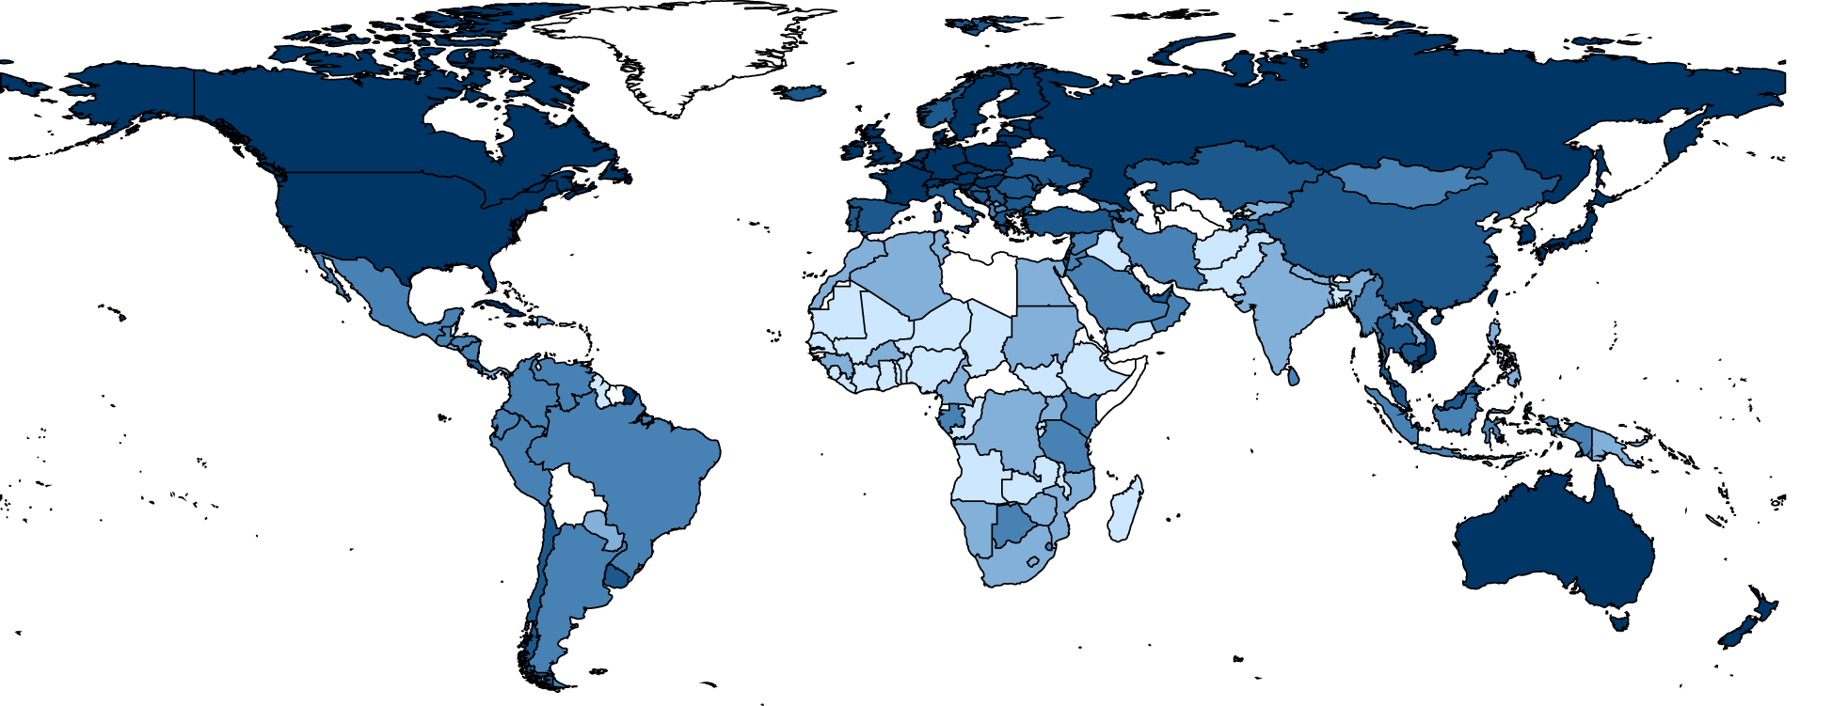
Clustering on World Development Measurements

Slide 2
Business Problem:
Creating clusters on the global development measurement dataset.
Objective:
The objective of the analysis is to form clusters based on the given global development measurement data.

Slide 3
Project Architecture / Project Flow
Understanding Data
Building Different Kinds of Clustering Models.
Selecting the Best Model.
Deployment
Deploying the Model using Streamlit.
Model Building, Model Selection & Validation
Exploratory Data Analysis (EDA)
Description of All Features
Plotting Distribution and Box plots.
Dimensionality Reduction
Data set Description.
Top and Bottom 15 Countries in every feature
PCA
T-SNE
Data Cleaning and preparation.

Slide 4
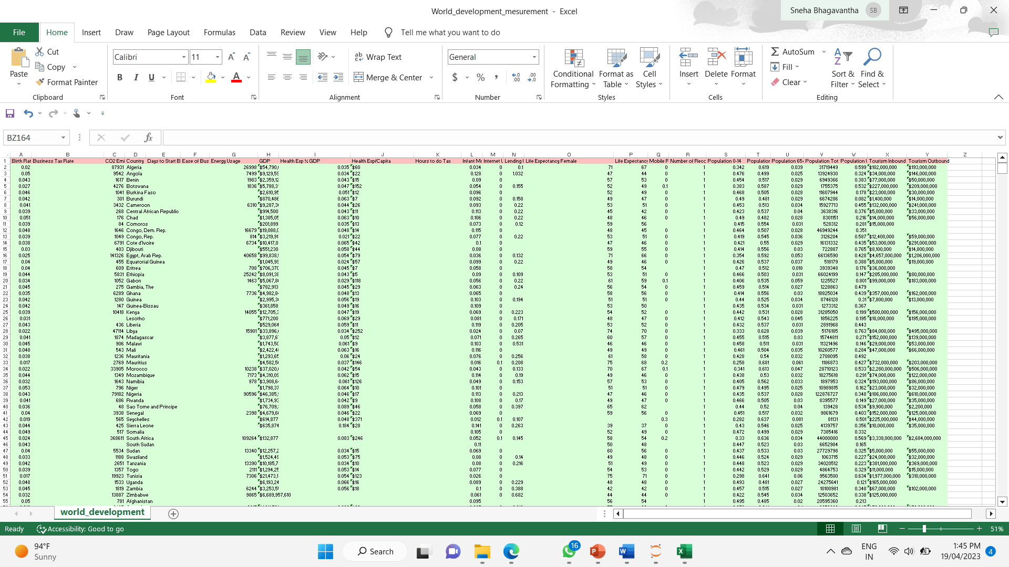
UNDERSTANDING THE DATA
Data set details
No. of Rows: 2704
No. of Features: 25
No. of Categorical Features: 1
No. of Continuous Features: 24
Screenshot of the Dataset

Slide 5
UNDERSTANDING THE DATA
Data set details
The given dataset is the world development measures dataset.
It contains the data of different measurement indexes of every country that spans over 13 years.
The dataset contains 2704 records and 25 features.
Out of 25 features 24 are Numerical features and the remaining one is a Categorical Feature i.e. Name of the country.
Even though the remaining features are numerical some values contain special characters like ‘$’,’%’ and ’,’, so the machine thinks of it as an object or a string.
The description of each feature:
Birth Rate: The Birth rate in the country
Business Tax Rate: The Business Tax rate in the Country
CO2 Emissions: Annual CO2 emissions of the country
Country: Name of the Country
Days to Start Business: Average number of days taken by an industry/company to start a business in that country
Ease of Business: Ranking of the country in terms of Ease of Doing Business
Energy Usage: Total energy usage of the country
GDP: Total GDP of the Country
Health Exp % GDP: Decimal value of Percentage of GDP spent on the Health Sector in the Country
Health Exp/Capita: The money spent on each individual of the country by health sector (in $)

Slide 6
UNDERSTANDING THE DATA
The description of each feature:
Hours to do Tax: Number of Hours to do Tax
Infant Mortality Rate: The infant mortality rate of the country
Internet Usage: The internet usage of the country
Lending Interest: The lending interest of the Country
Life Expectancy Female: The average Life expectancy of Females in the Country
Life Expectancy Male: The average Life expectancy of Males in the Country
Mobile Phone Usage: The Mobile usage in the country
Number of Records: The Number of records from which the data is collected.
Population 0-14: Decimal value of Percentage of the population aged between 0 and 14 in the Country
Population 15-64: Decimal value of Percentage of the population aged between 15 and 64 in the Country
Population 65+: Decimal value of Percentage of the population aged above 64 in the Country
Population Total: Total population of the Country
Population Urban: Decimal value of Percentage of population living in urban areas of the Country
Tourism Inbound: The amount of revenue generated by foreign Inbound tourists in the country.
Tourism Outbound: The amount of revenue generated by the outbound tourists from the country.

Slide 7
Exploratory Data Analysis (EDA) and
Feature Engineering

Slide 8
What we have done with the data?
Exploratory Daya Analysis (EDA)
Describing data
Renaming columns
Removing symbols & convert objects into float datatypes
Dealing with Missing values
Dropping Unnecessary columns
Duplicate values
Correlation
Outliers
Visualizations

Slide 9
Dealing with NULL Values:
Exploratory Daya Analysis (EDA)
We observed that there are so many NULL values in every feature of the dataset.
Before dealing with NULL values, We dropped some unnecessary columns and renamed some columns for our use.
To deal with these NULL values we proceeded with the KNN Imputer module.
Before Imputing the NULL values with the KNN Imputer, we need to normalize the data.
KNN Imputer uses K-Nearest Neighbour Algorithm to impute the NULL values.
After completing the imputation, we observed that there are 208 unique Country names and each name is repeated 13 times.
This indicates that this dataset contains data in a span of 13 years.
So we used ‘groupby’ method to group the data by Country name.
This newly grouped dataset ‘final_df’ contains 208 entries with 23 features along with the Country name.

Slide 10
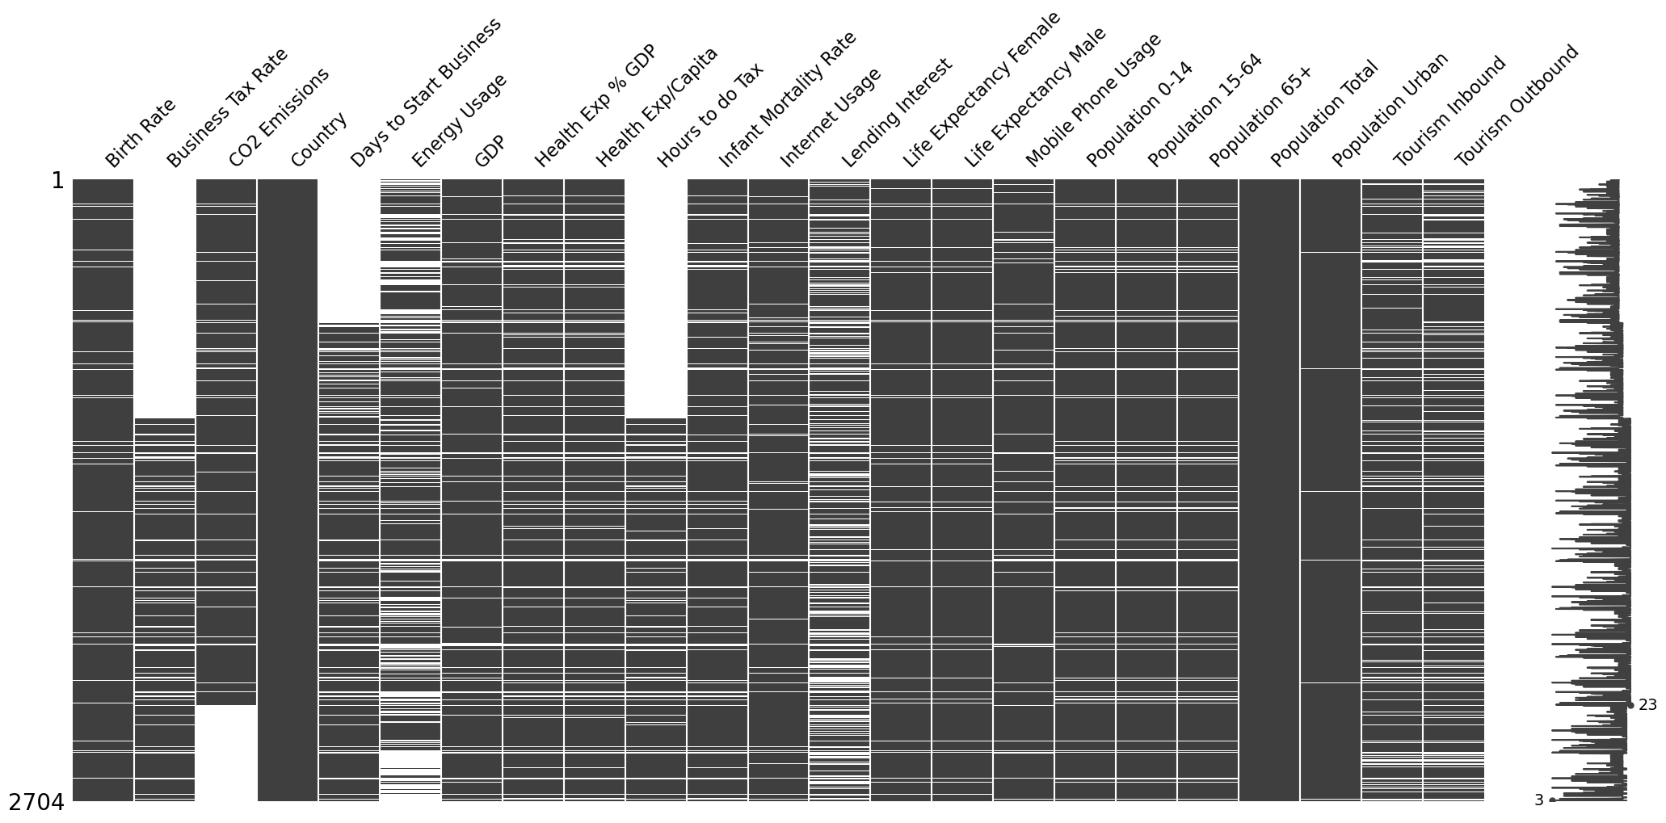
Exploratory Data Analysis (EDA)
Representation of NULL values.

Slide 11
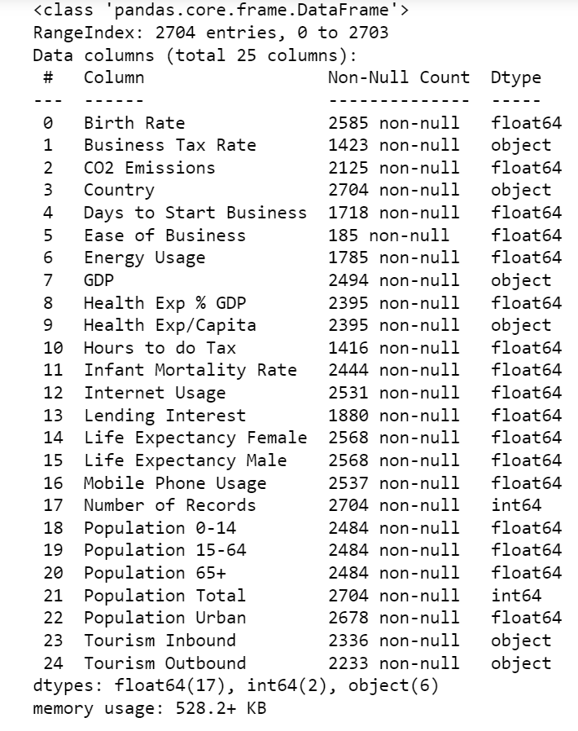
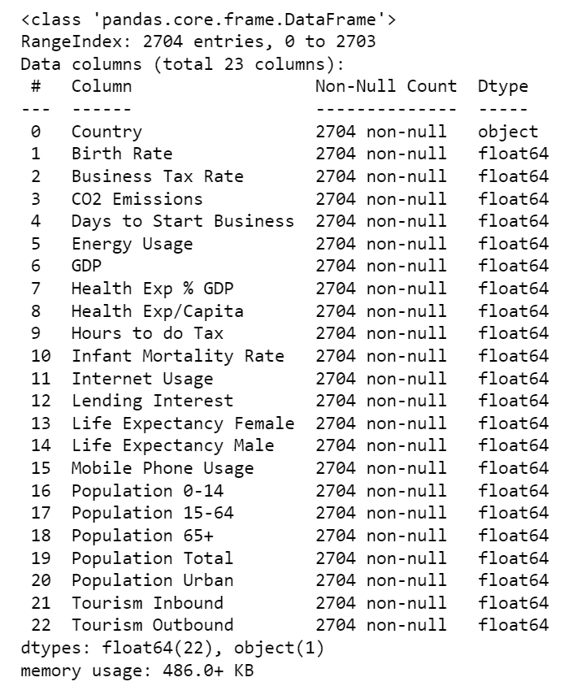
Exploratory Data Analysis (EDA)
Dealing with Datatypes, NULL values and Unnecessary columns
BEFORE:
AFTER:

Slide 12
Exploratory Data Analysis (EDA)
Representation of Correlation between Features

Slide 13
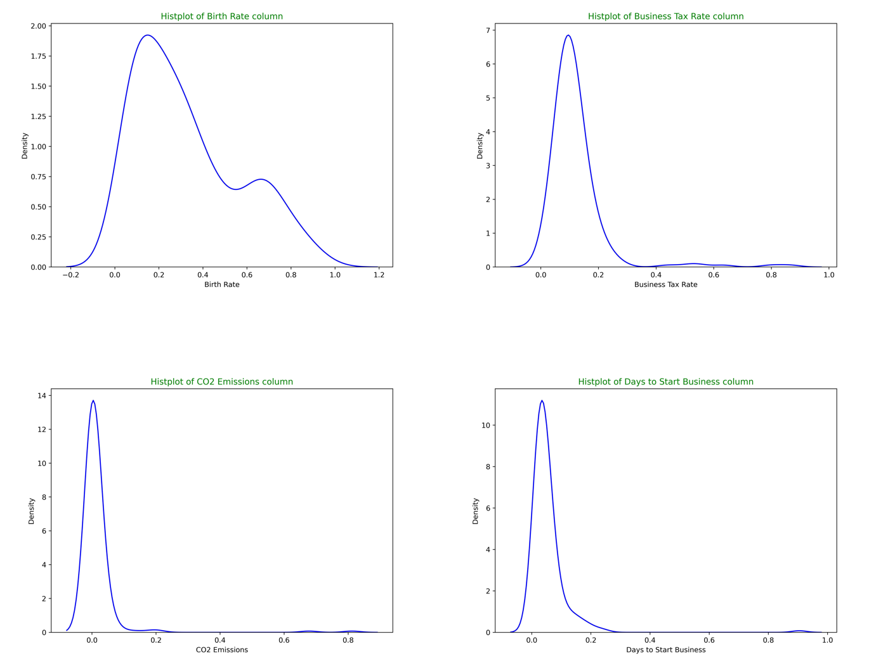
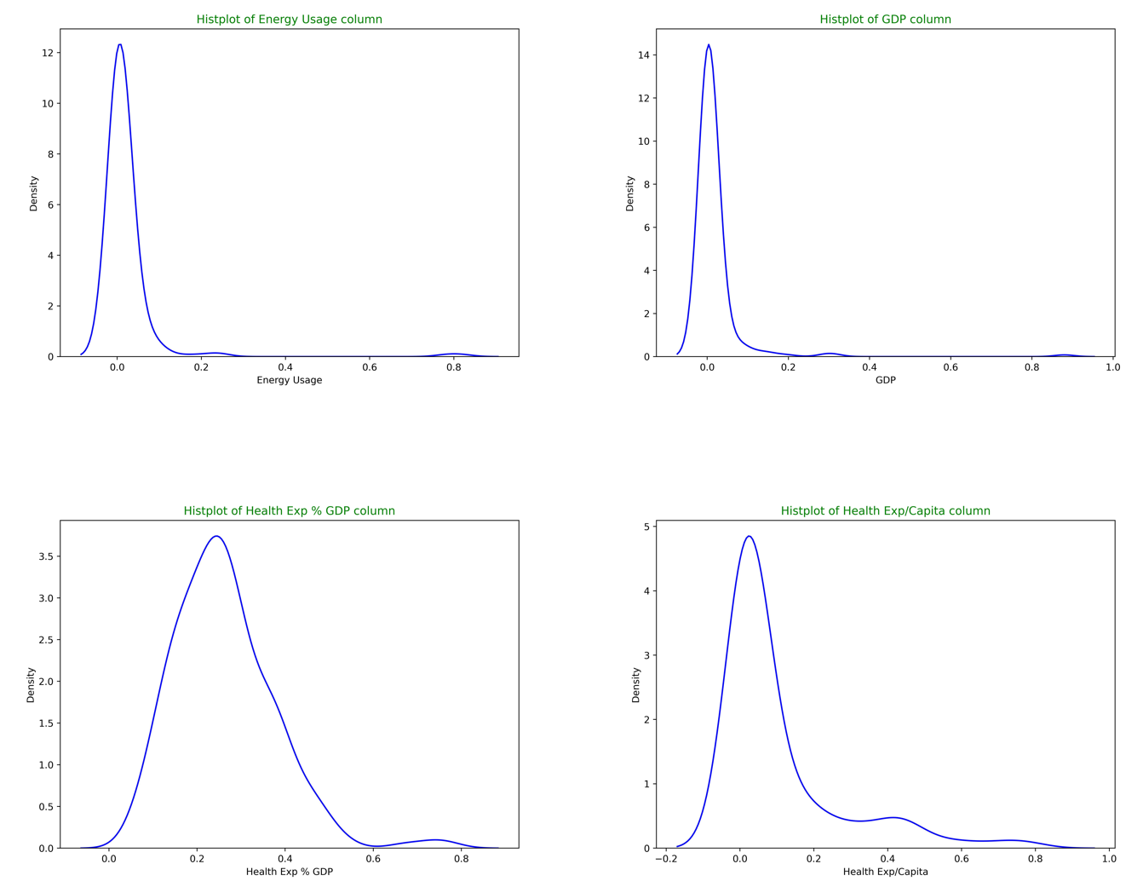
Exploratory Data Analysis (EDA)
Distribution Plots of all Features

Slide 14
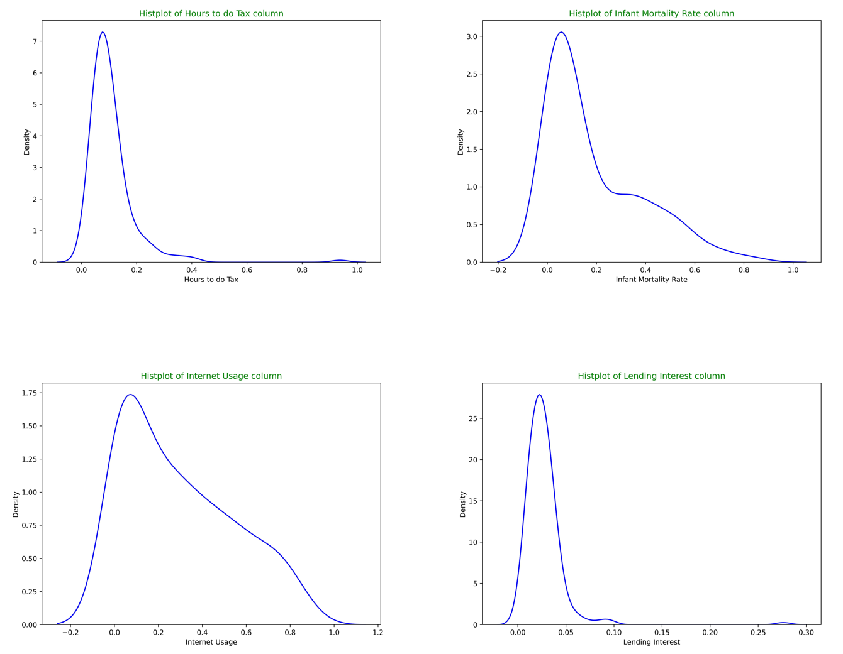
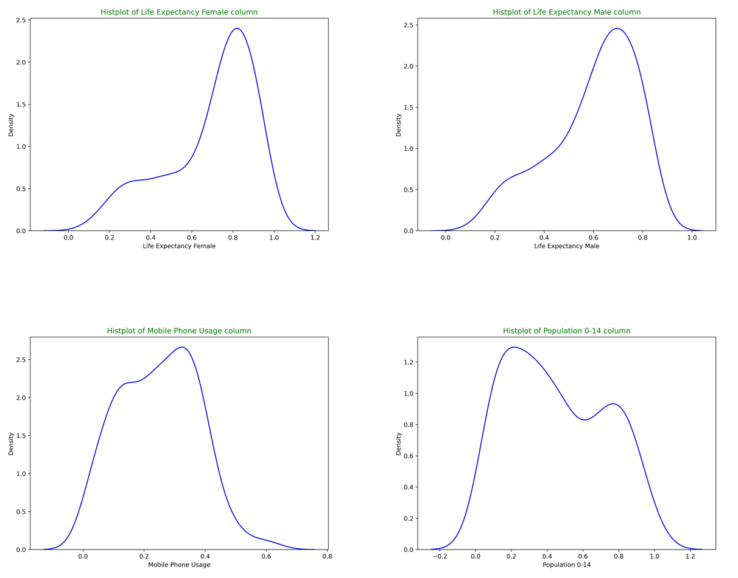
Exploratory Data Analysis (EDA)
Distribution Plots of all Features

Slide 15
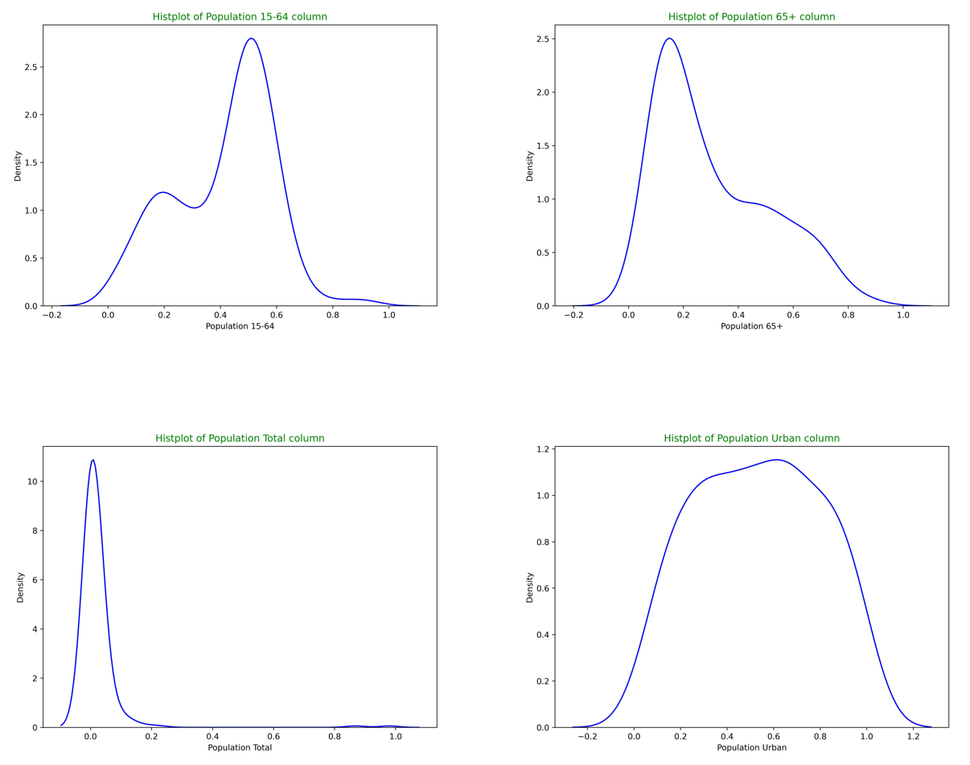
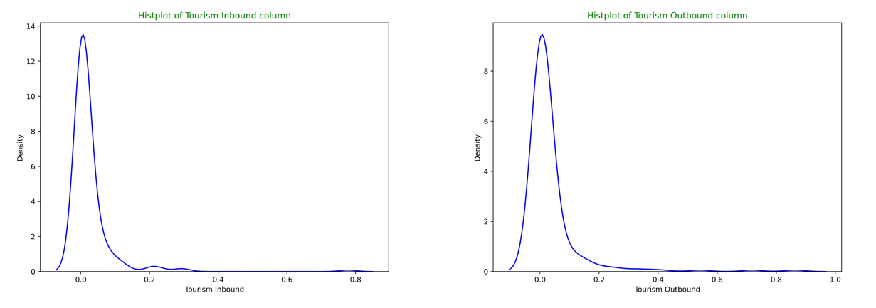
Exploratory Data Analysis (EDA)
Distribution Plots of all Features

Slide 16
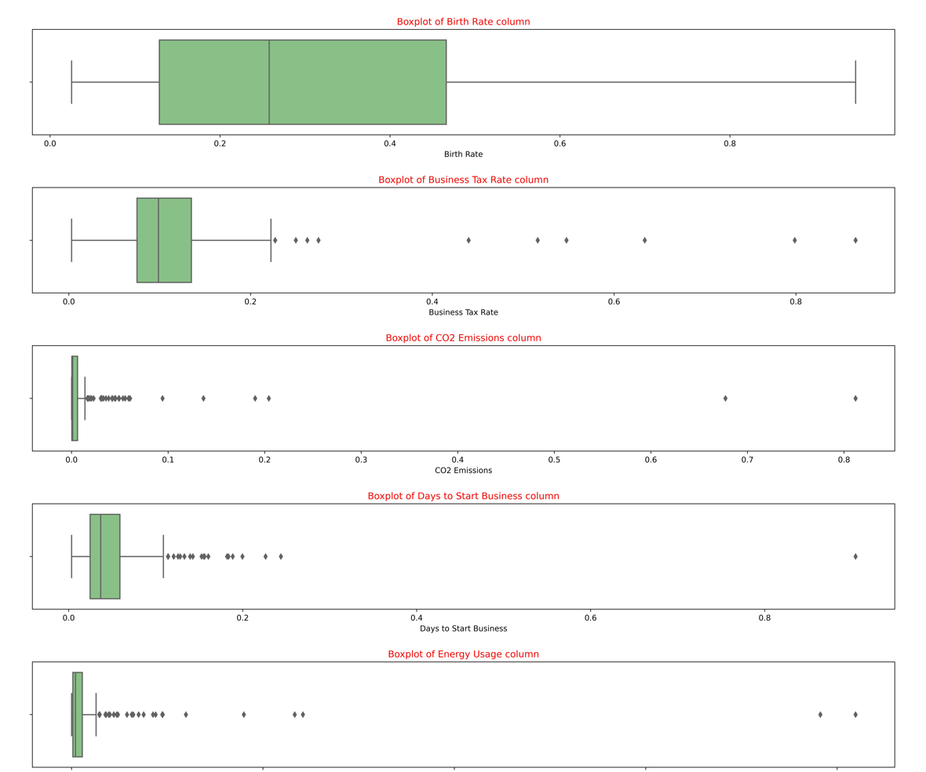
Exploratory Data Analysis (EDA)
Box Plots of all Features

Slide 17
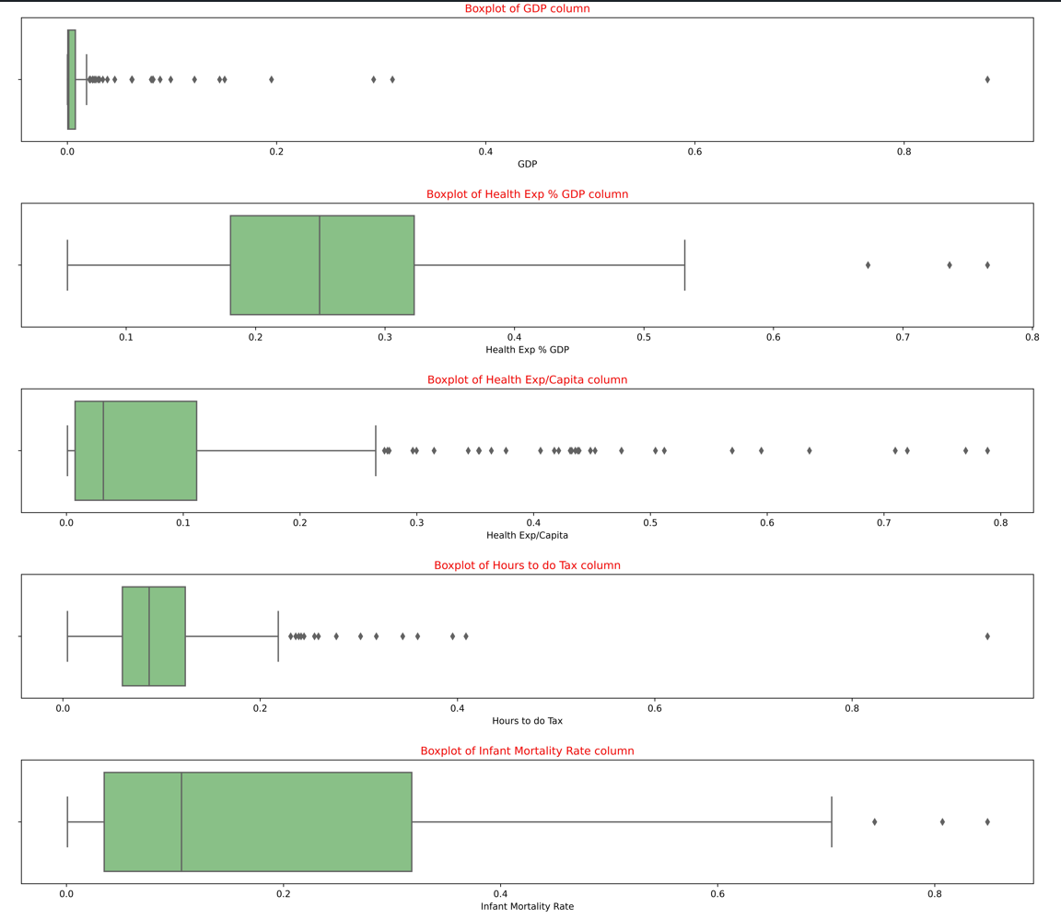
Exploratory Data Analysis (EDA)
Box Plots of all Features

Slide 18
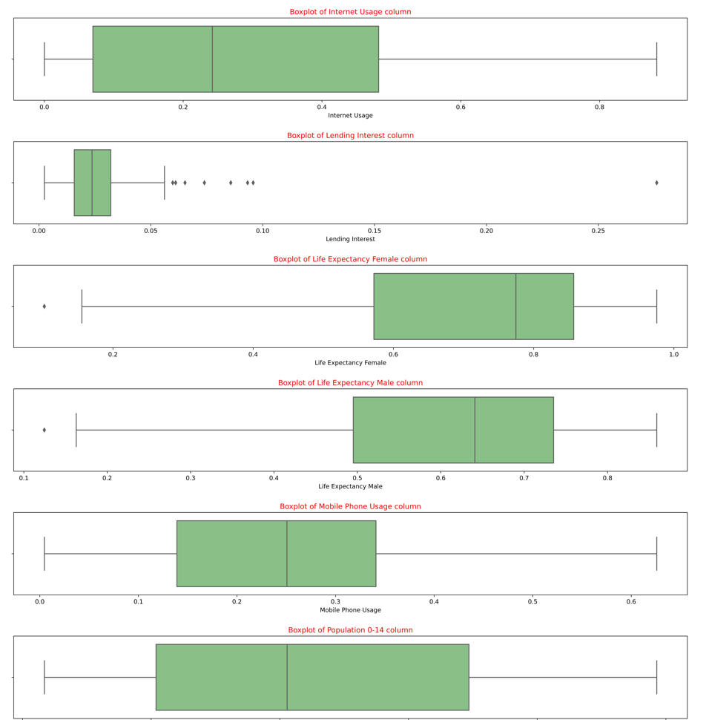
Exploratory Data Analysis (EDA)
Box Plots of all Features

Slide 19
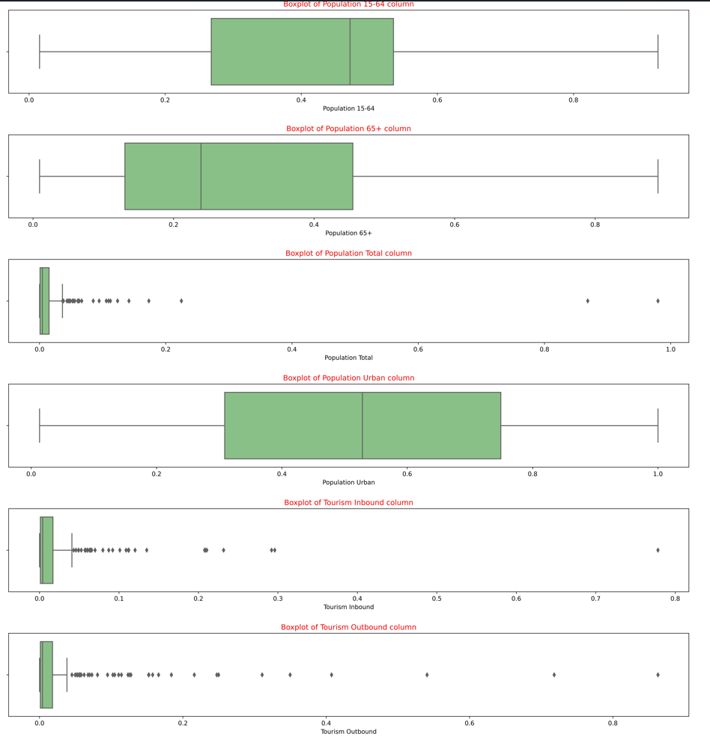
Exploratory Data Analysis (EDA)
Box Plots of all Features

Slide 20
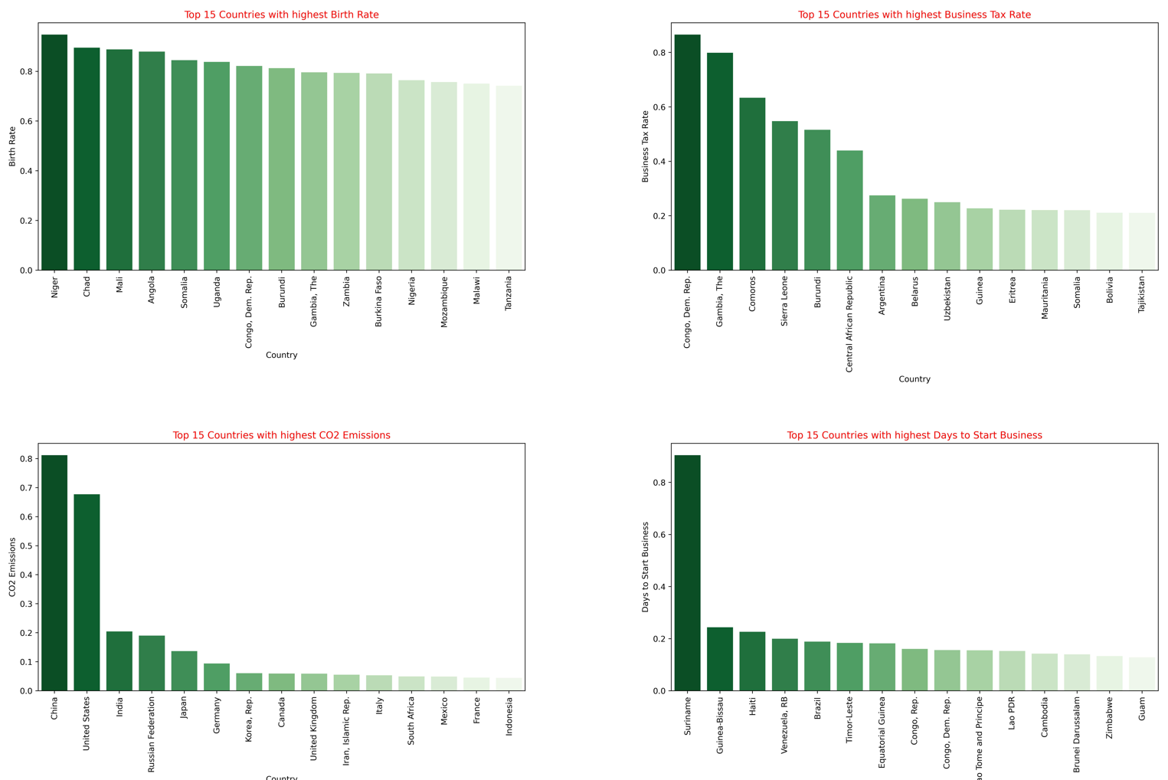
Exploratory Data Analysis (EDA)
Top 15 Countries in all Features

Slide 21
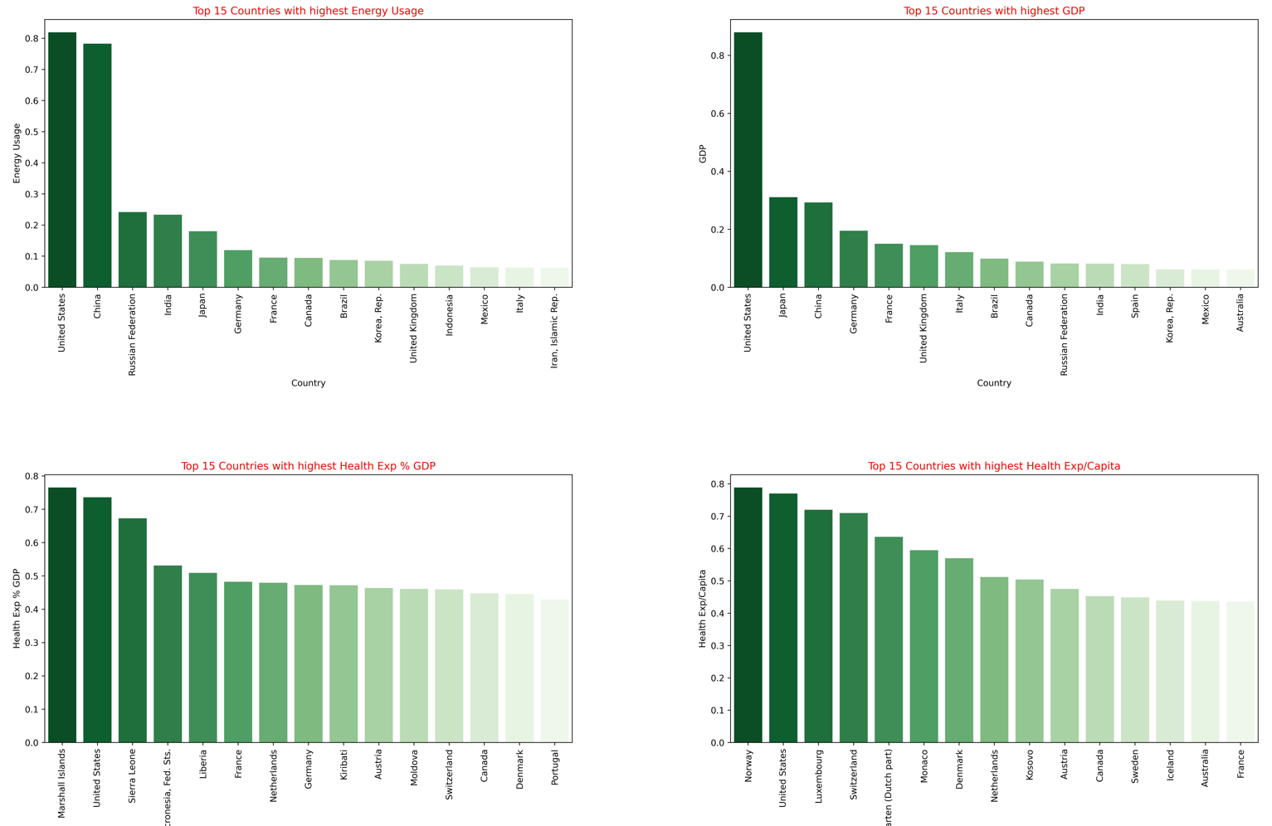
Exploratory Data Analysis (EDA)
Top 15 Countries in all Features

Slide 22
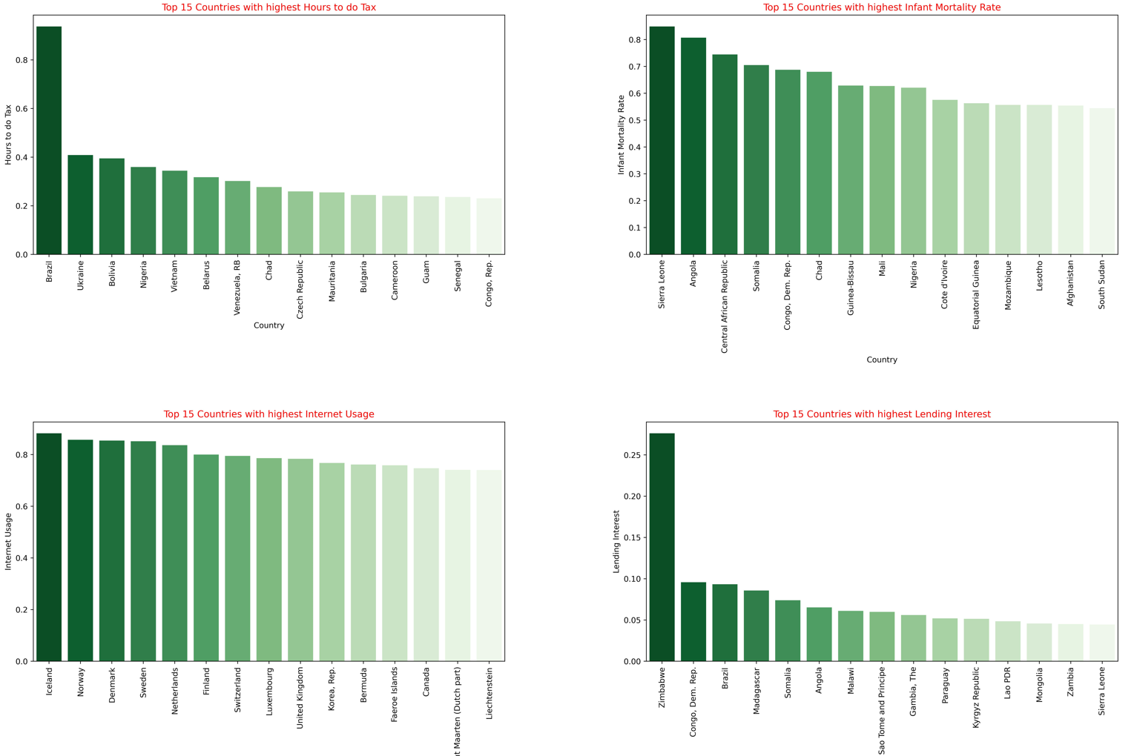
Exploratory Data Analysis (EDA)
Top 15 Countries in all Features

Slide 23
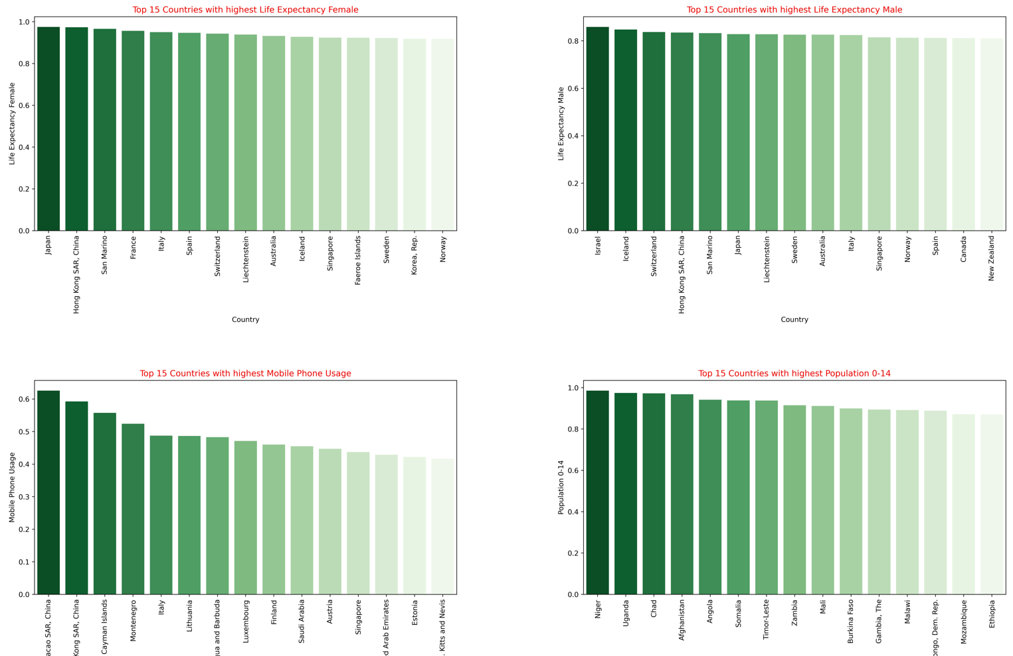
Exploratory Data Analysis (EDA)
Top 15 Countries in all Features

Slide 24
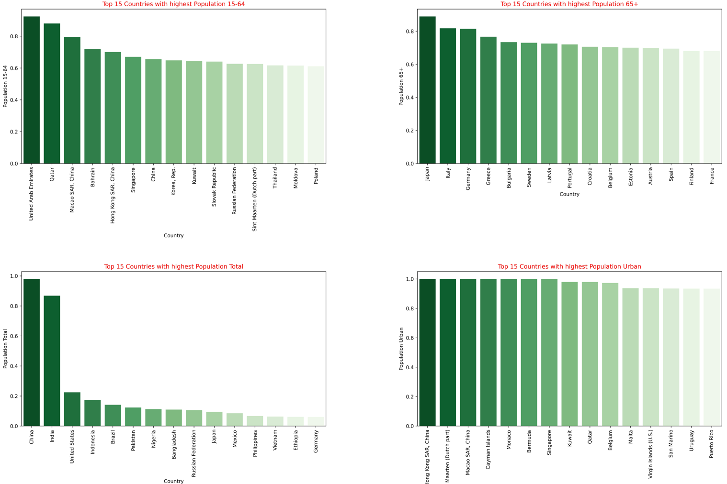
Exploratory Data Analysis (EDA)
Top 15 Countries in all Features

Slide 25
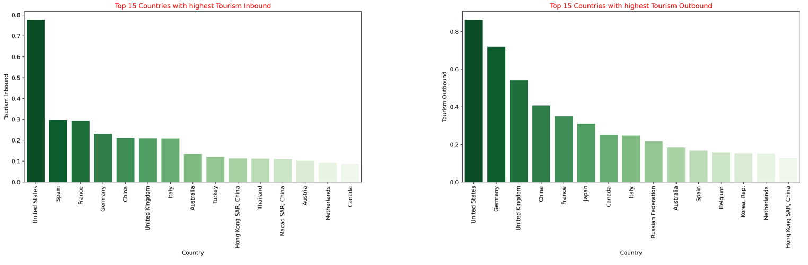
Exploratory Data Analysis (EDA)
Top 15 Countries in all Features

Slide 26
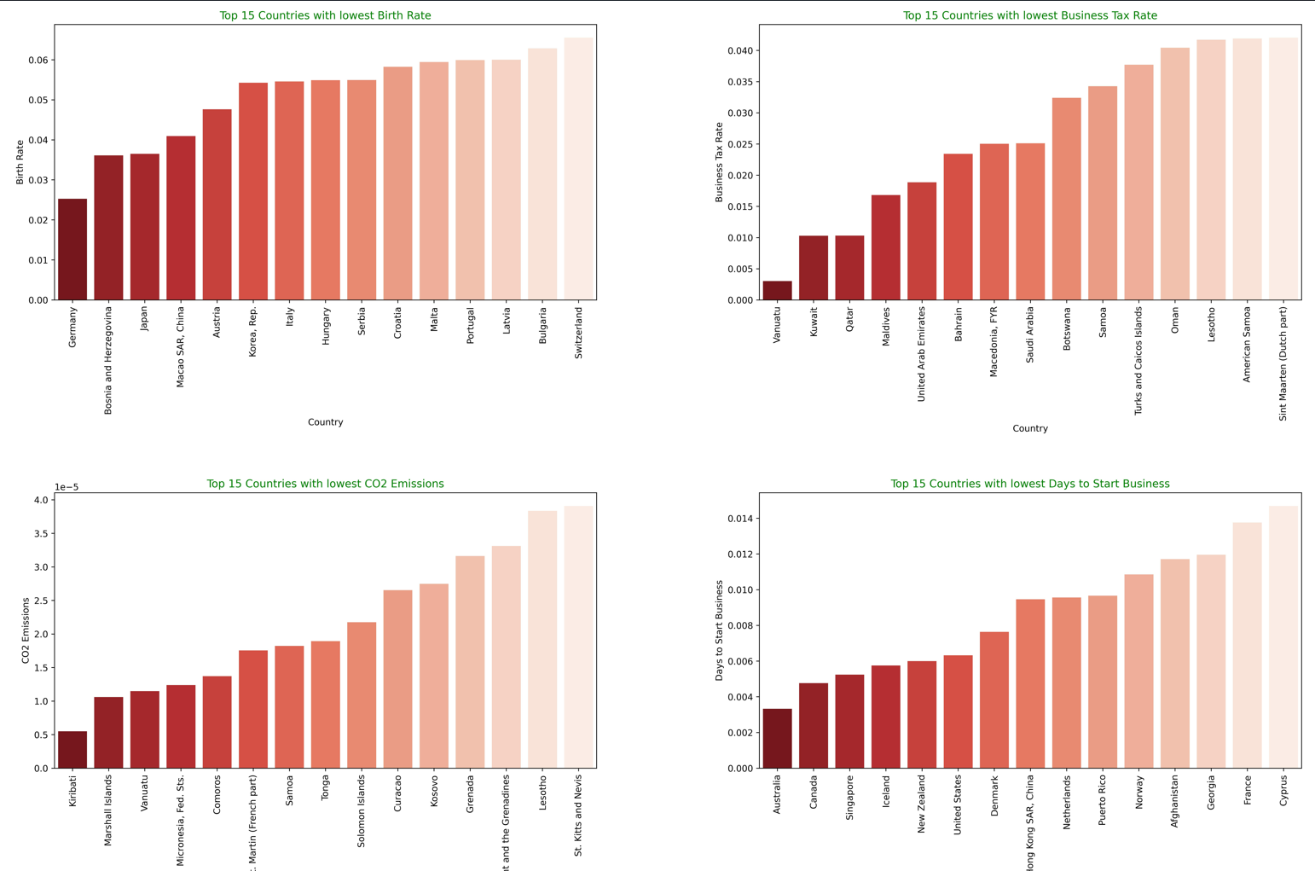
Exploratory Data Analysis (EDA)
Bottom 15 Countries in all Features

Slide 27
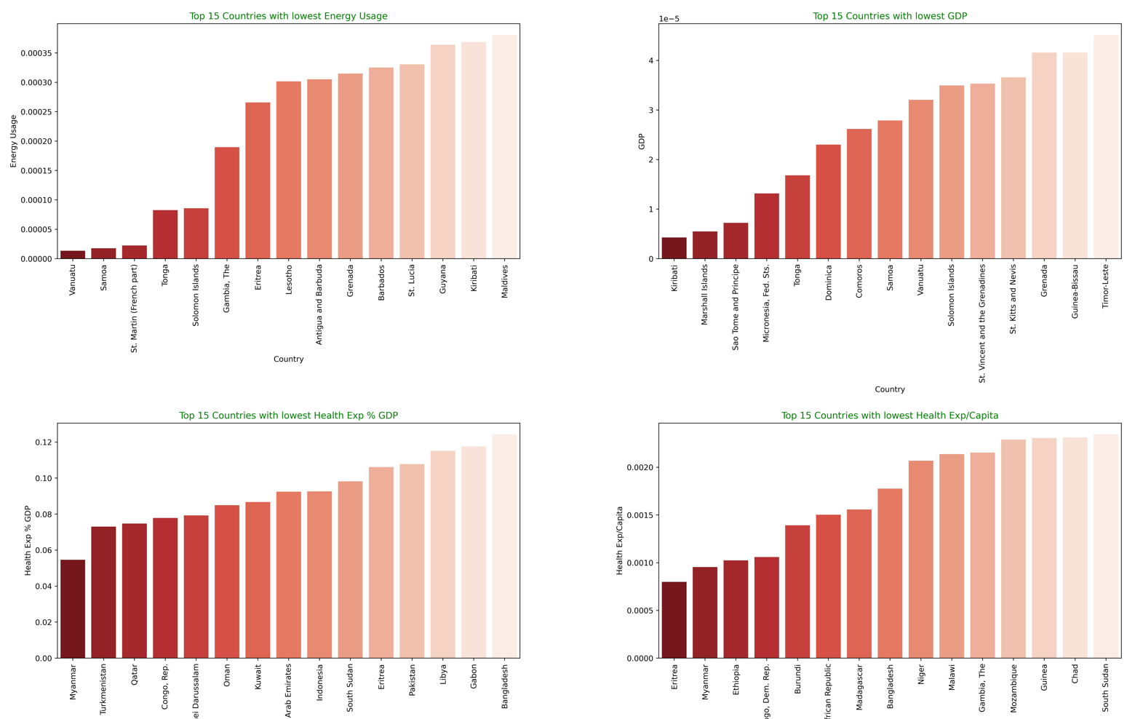
Exploratory Data Analysis (EDA)
Bottom 15 Countries in all Features

Slide 28
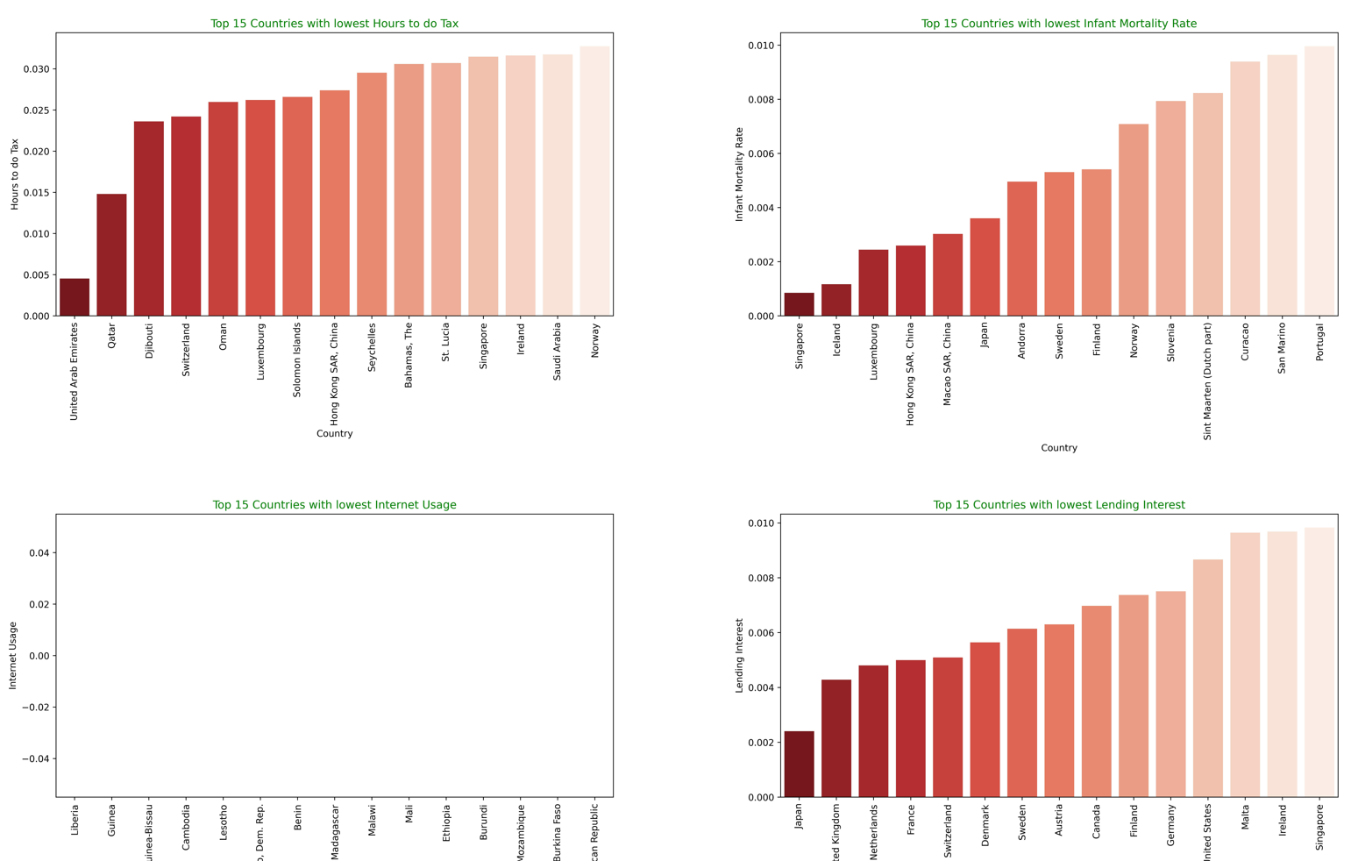
Exploratory Data Analysis (EDA)
Bottom 15 Countries in all Features

Slide 29
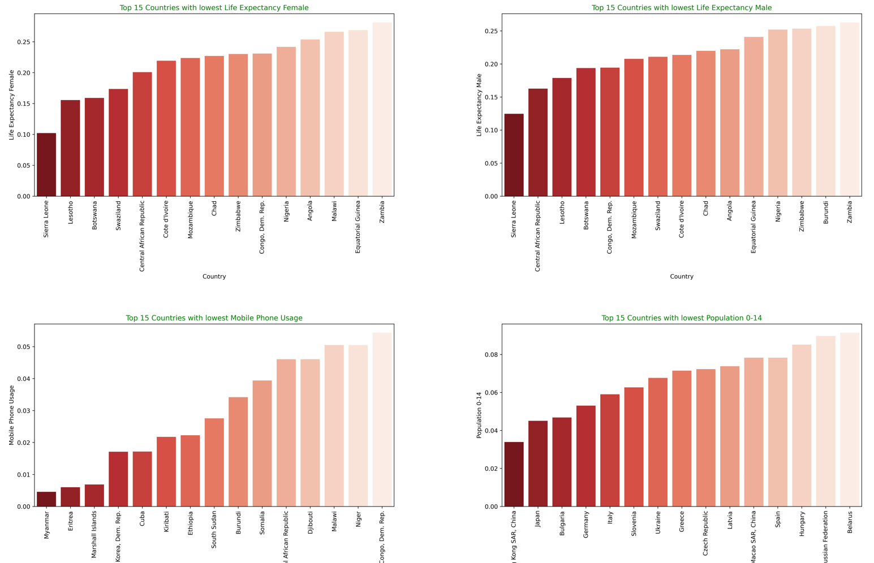
Exploratory Data Analysis (EDA)
Bottom 15 Countries in all Features

Slide 30
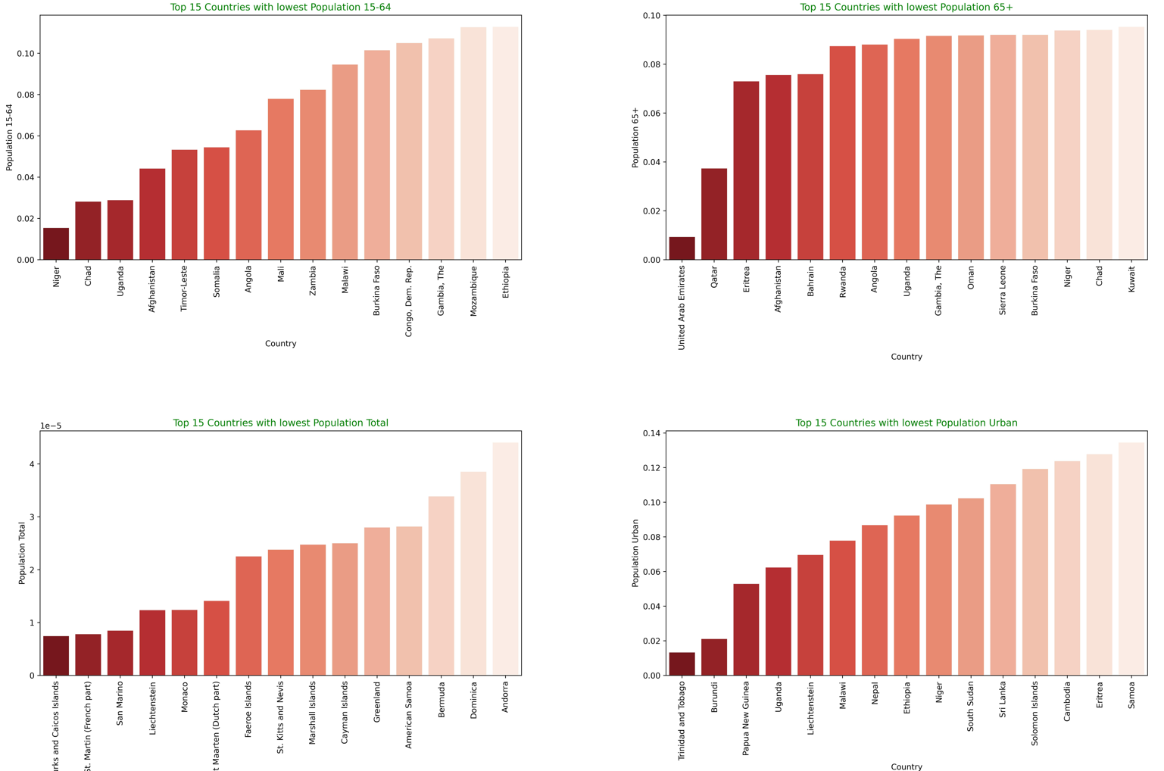
Exploratory Data Analysis (EDA)
Bottom 15 Countries in all Features

Slide 31
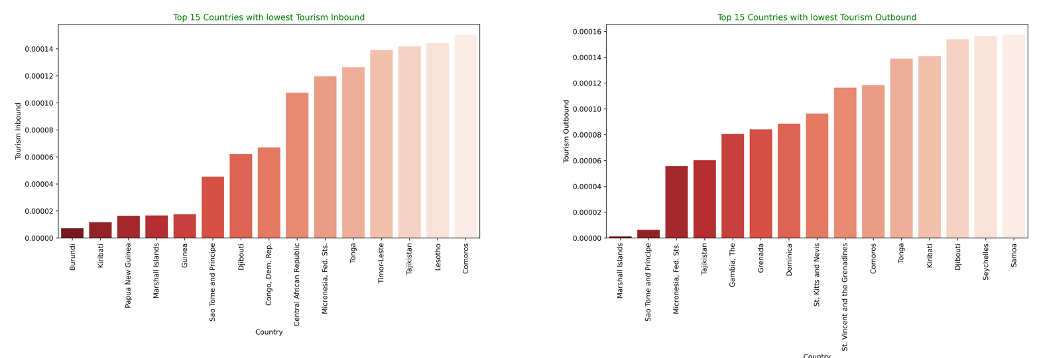
Exploratory Data Analysis (EDA)
Bottom 15 Countries in all Features

Slide 32
INSIGHTS
The Major Insights gained by observing all the Graphs are:
None of the features has a Perfect Normal Distribution.
Most of the feature has Right-Skewed data.
Every feature has many outliers.
The Countries having higher Tourism Inbound & Outbound are having higher GDP
The countries which emit more CO2 and use more energy are among the Top at GDP.
Highest populated countries are amongst the top Consumers of Energy and top contributors of CO2 emissions. But the highest populated countries are not at the top of GDP in most cases.
The more the Tourism Sector, the more the Energy Usage and CO2 emissions
The above scenarios conclude that the countries which are highly industrialized and top tourist destinations are having highest GDP.
The more mobile usage in a country, the more Internet usage.
People who are at the age of 65+ use Mobile more than people who are 15-64

Slide 33
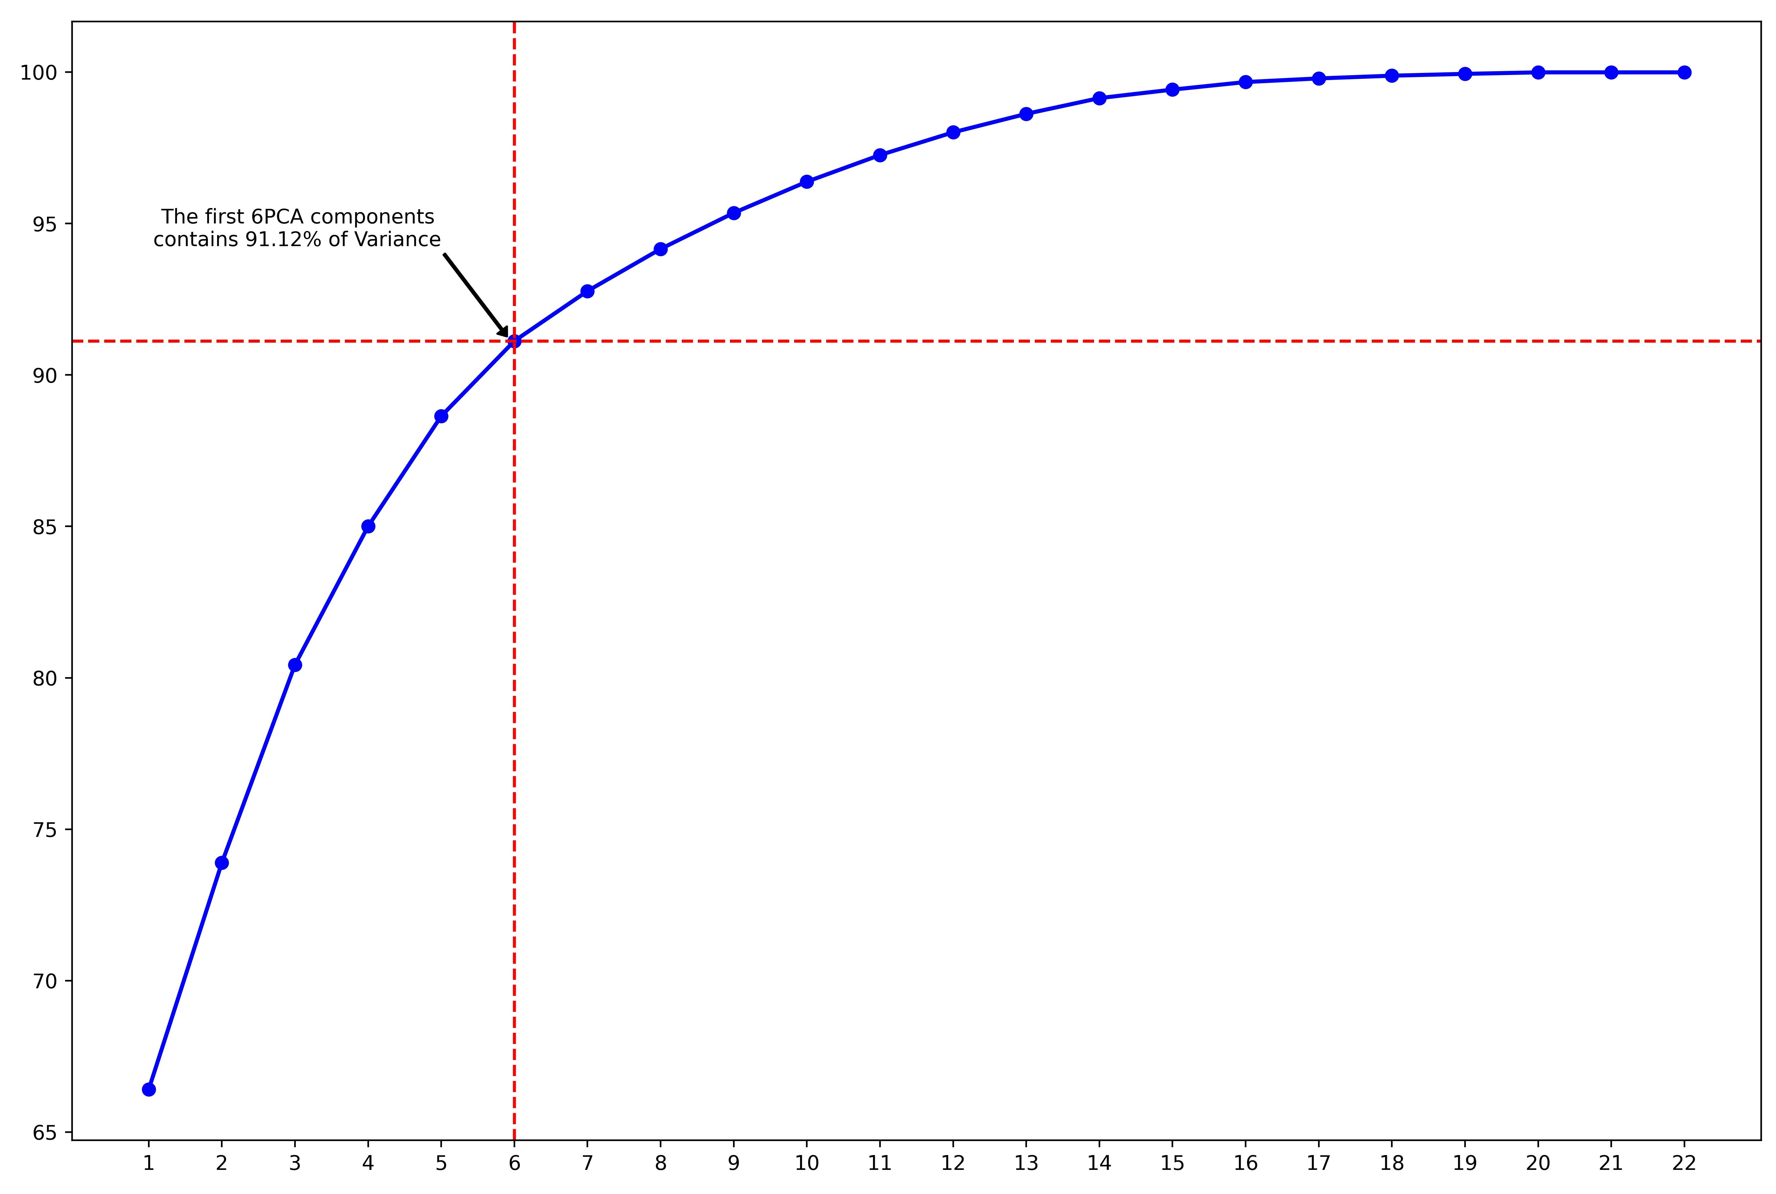
DIMENSIONALITY REDUCTION:
PRINCIPAL COMPONENT ANALYSIS
It is Dimensionality Reduction Technique.
In this Analysis, we change the coordinate axes without disturbing the data points such that, most of the variance of data lies on one axis.
Here, out of 22 dimensions of the data, we got 91.12 % variance of data in only 6 dimensions.

Slide 34
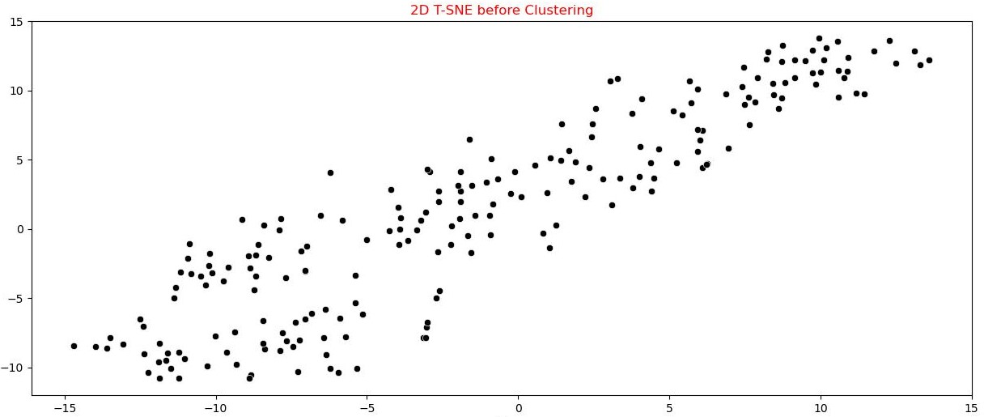
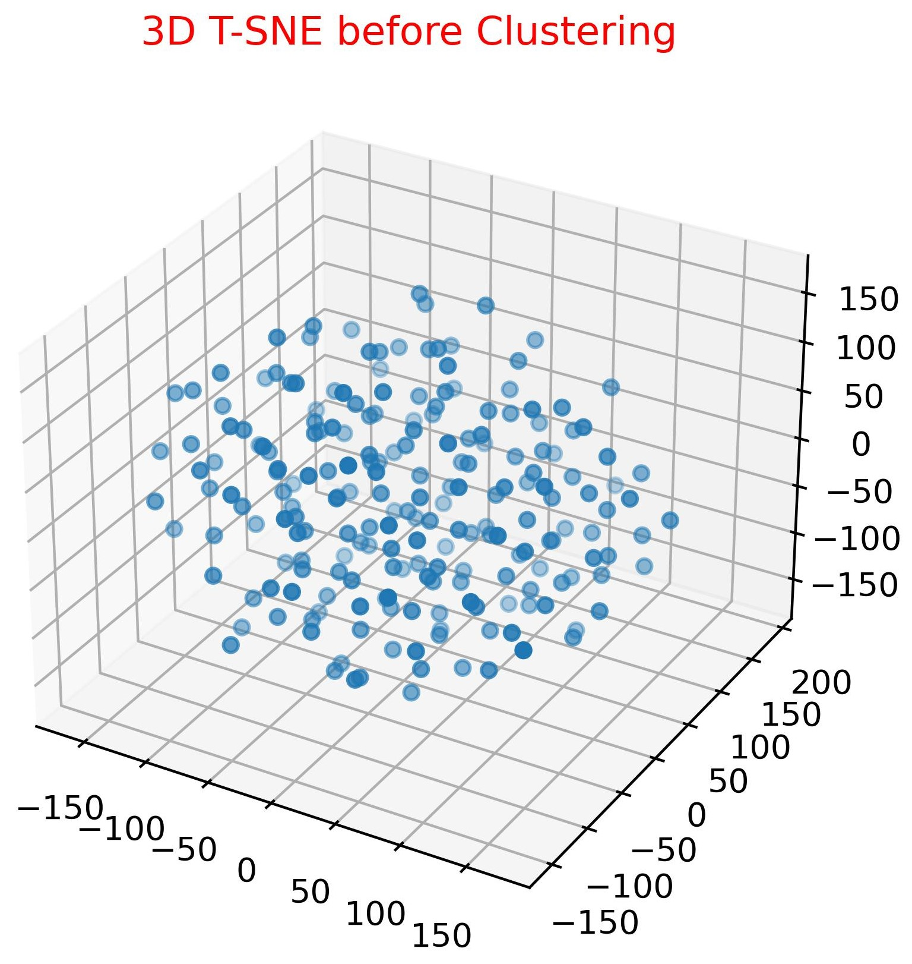
DIMENSIONALITY REDUCTION:
T-SNE
It is a Dimensionality reduction technique used for Visualizing heavy dimensional data in a 2-D or 3-D plot.
The below graphs show all the 208 data points of the final_df data frame in 2-D and 3-D Scatter plots.

Slide 35
CLUSTERING
Clustering is a process of grouping a set of objects or data points into subsets or clusters based on their similarity in some predefined way. The goal of clustering is to create groups of objects that are more similar to each other than to objects in other clusters while maximizing the dissimilarity between different clusters.
Clustering Techniques Used in this Project :
Hierarchical Clustering
Kmeans Clustering
DBSCAN

Slide 36
Hierarchical Clustering
Hierarchical clustering is a clustering algorithm that aims to create a hierarchy of nested clusters by recursively partitioning a set of objects or data points. The algorithm starts by considering each object as a separate cluster and then proceeds iteratively to merge clusters based on their similarity or dissimilarity. The result of the algorithm is a tree-like structure, called a dendrogram, that represents the hierarchy of clusters.
What we have done?:
We Used the Agglomerative Hierarchical Clustering technique in our project.
We used the Complete linkage method in our clustering.
We build the models with distinct numbers of clusters in the range of 2 to 10 to check which model gives us the best performance.
After plotting a Scree plot, we conclude, the model with 4 different Clusters gives us the highest Silhouette Score.
So we build a Model with 4 Clusters and got a Dendrogram.
The Scree plot and Dendrogram of the Clustering Model are___

Slide 37
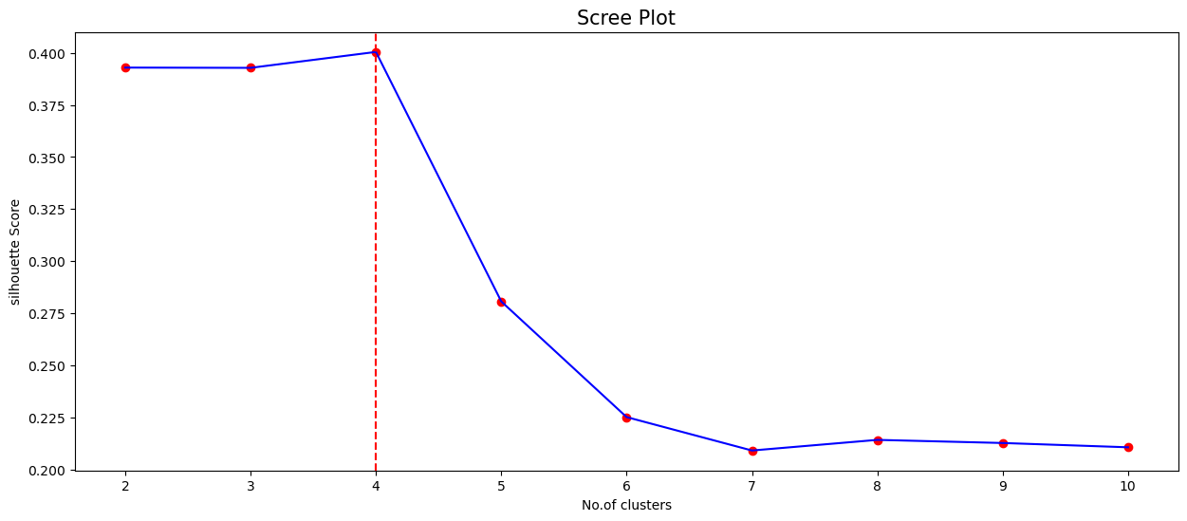
SCREE PLOT

Slide 38
DENDROGRAM

Slide 39
KMeans Clustering
KMeans clustering is a popular unsupervised machine learning algorithm for grouping similar data points together based on their similarity or distance. The algorithm partitions a dataset into K clusters where each data point belongs to the cluster whose centroid is nearest to it. The algorithm starts by randomly assigning K centroids to the data points and iteratively moves them until convergence. The centroid is the mean of the data points in a cluster. The objective of the algorithm is to minimize the sum of the squared distances between each data point and its assigned centroid.
What we have done?:
Before building the model, we need to select our hyperparameter i.e. ‘K’.
To obtain the best K value, we used KelbowVisualizer from the yellowbrick module.
KElbowVisualizer gave us an Elbow plot.
The Elbow plot suggests that the best value for “K” will be ‘6’.
So, we built the KMeans model using Scikit learn module with K=6.
We got a Silhouette Score of 0.2454625313727169.
The Elbow plot and KMeans Visualization graphs are__

Slide 40
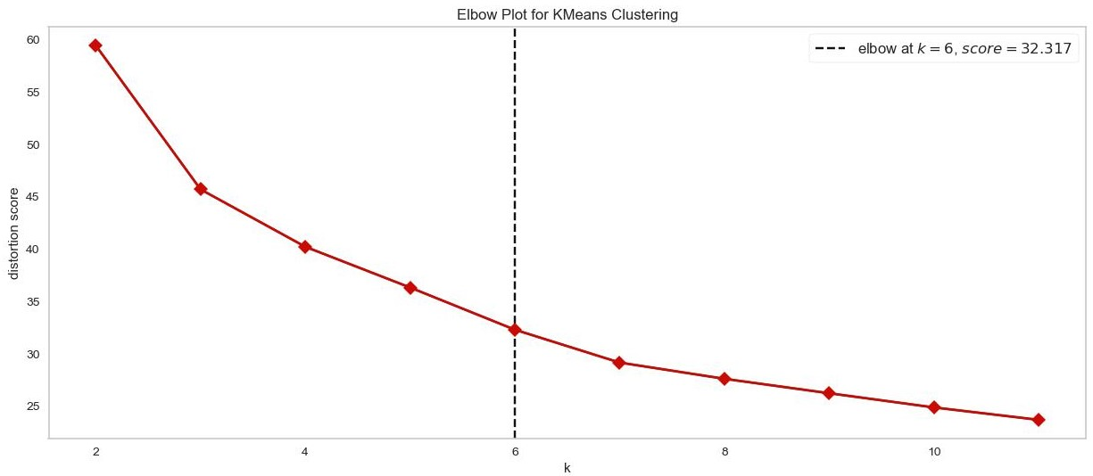
Elbow Plot

Slide 41
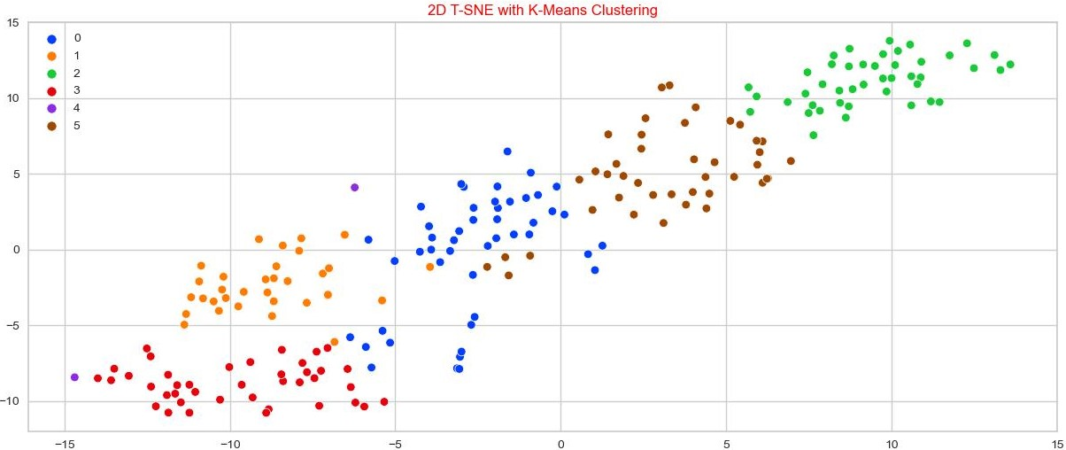
KMeans visualization with 2D T-SNE

Slide 42
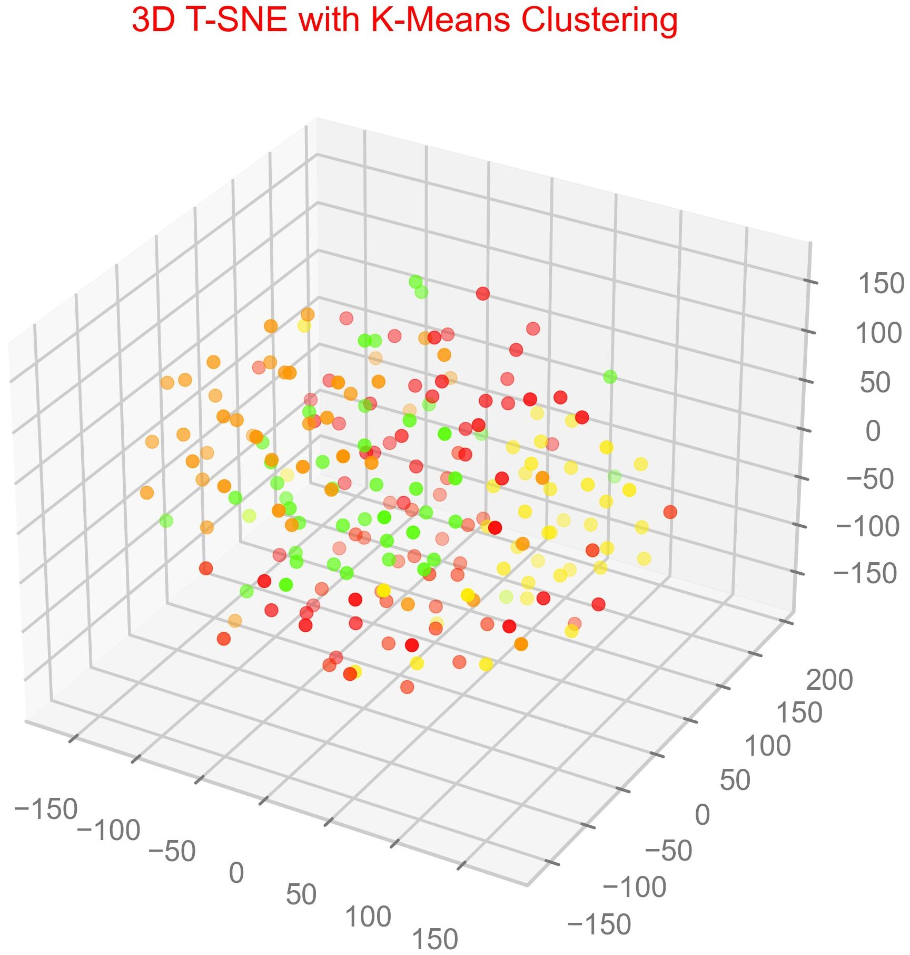
KMeans visualization with 3D T-SNE

Slide 43
DBSCAN
DBSCAN (Density-Based Spatial Clustering of Applications with Noise) is a popular clustering algorithm used in machine learning and data mining to group together similar data points based on their proximity to each other in a high-dimensional space.
The algorithm works by defining a neighborhood around each data point, and then grouping together points within a certain distance (epsilon) with a minimum number of neighbors (min_samples) within that neighborhood. Points that do not belong to any group are considered noise.
What we have done?:
Before building the model, we need to select our hyperparameters i.e. ‘epsilon’ & ‘min_samples’.
To obtain these, we build the DBSCAN models with 800 equidistant epsilon values ranging from 0.2 to 5 and min_samples in a range of 2 to 20.
Then we calculated Silhouette scores for every model and selected the model with the highest score.
The best model has an epsilon value of 0.3381727158948686 and the min_samples value is 12.
The Silhouette Score of the best model is 0.13818596650453274.
The DBSCAN Visualization graphs are__

Slide 44
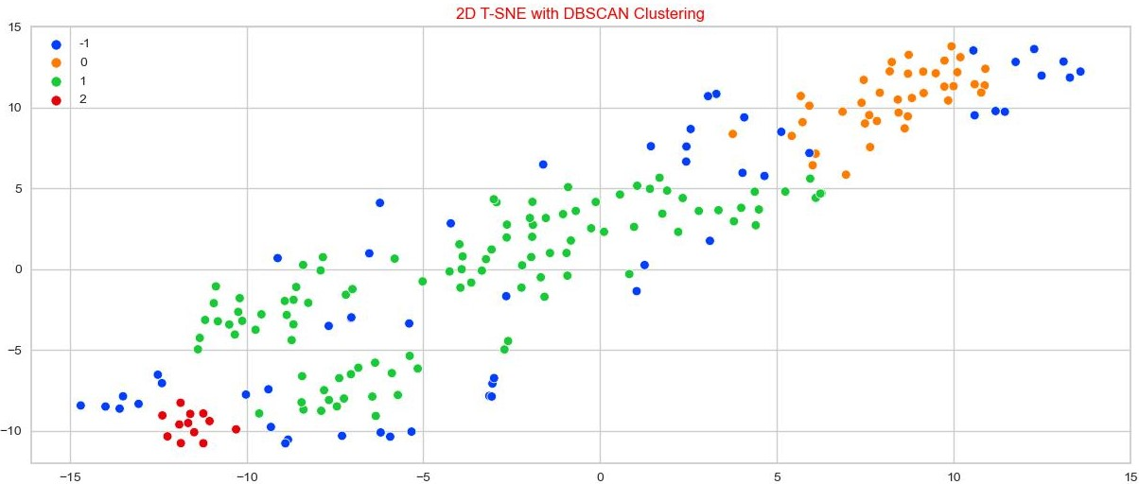
DBSCAN visualization with 3D T-SNE

Slide 45
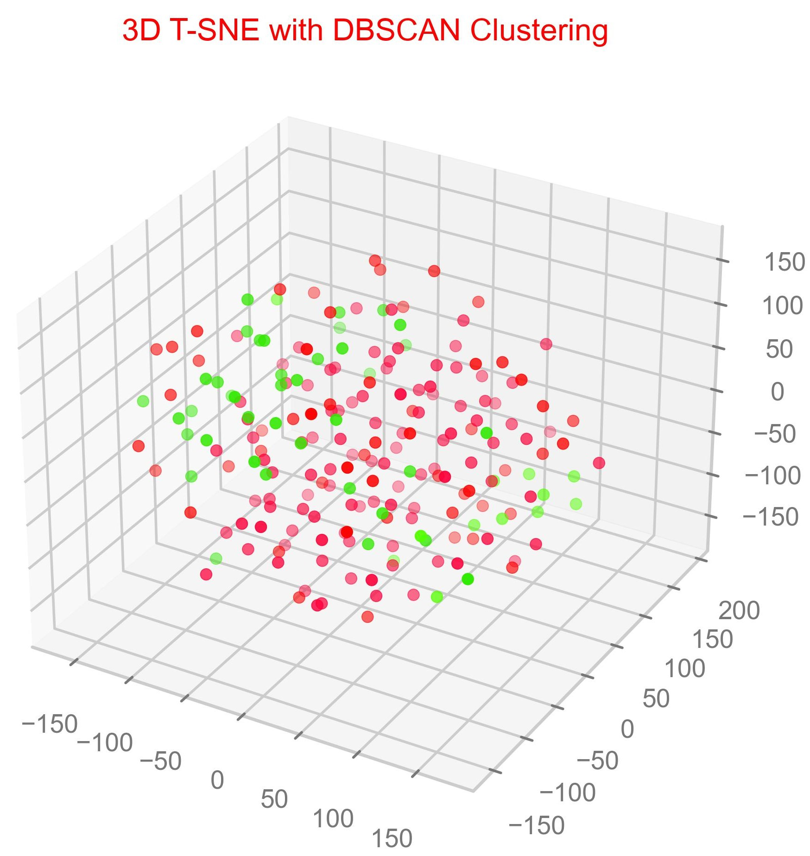
DBSCAN visualization with 3D T-SNE

Slide 46
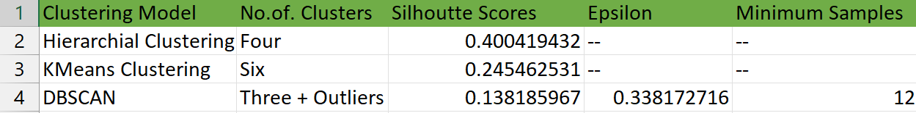
Model Selection and Validation:
After Performing all three Clustering techniques on the final_df dataset, the Optimal Number of Clusters, Silhouette scores and other important values stand like this ⬇️.
After checking the Optimal Number of Clusters, Silhouette scores and other important values for all three clustering techniques, the observations are
DBSCAN technique with the best hyperparameters has the least silhouette score among all the three techniques.
Agglomerative Clustering(Hierarchical Clustering) with four Clusters has the best Silhouette score among all.
KMeans Clustering with K=6 (Which is the best ‘K’ value according to KElbowVisualizer’s Elbow plot) has a score of 0.245 approx.

Slide 47
Model Selection and Validation:
Even though the KElbowVisualizer gave K=6 as the best K value, we can not see a clear elbow in the elbow plot.
If we include K=1 (Even though it is not recommended)also while plotting the Elbow plot, we can see a clear elbow at K=3.
Elbow plot without the inclusion of K=1

Slide 48
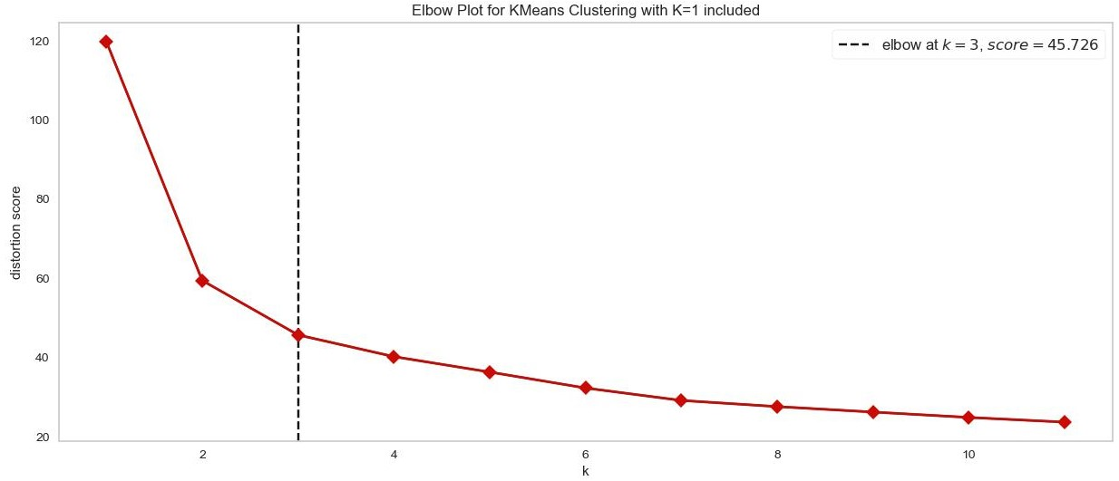
Model Selection and Validation:
Elbow plot with the inclusion of K=1

Slide 49
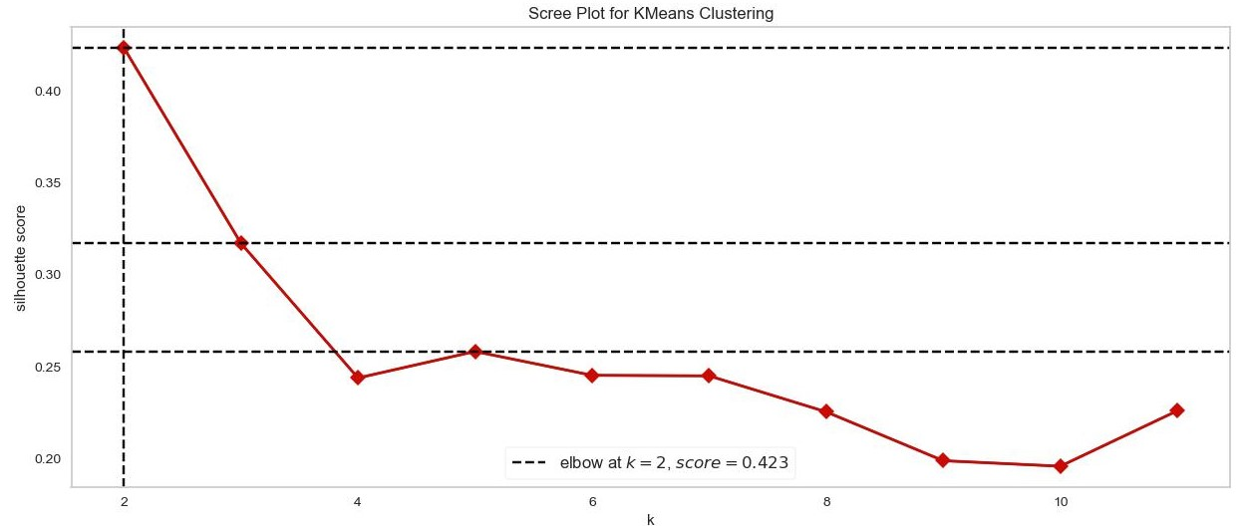
Model Selection and Validation:
Not only in the Elbow plot, but we can see ambiguity in also the Scree plot of the Kmeans algorithm.
We got The best Silhouette score for K=2, but not for K=6.
Even the top 3 Silhouette scores do not correspond to K=6.
We can see that in the Scree plot for Kmeans.
The top 3 best scores correspond to K= 2,3 and 5.

Slide 50
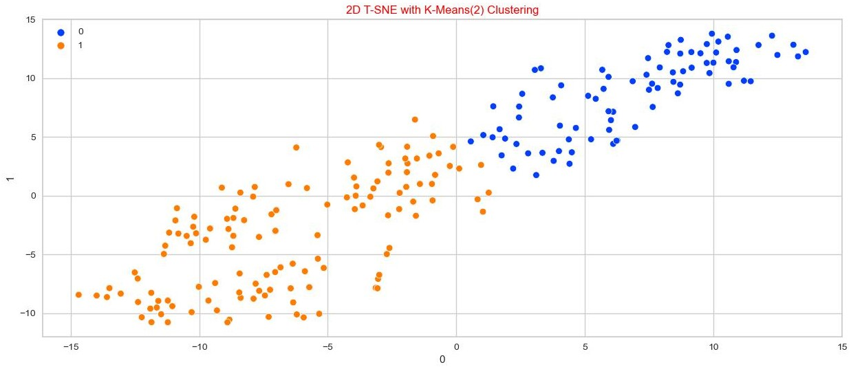
Model Selection and Validation:
Even though K=2 got the best Silhouette Score , we can not use K=2 for our dataset as we will only get two clusters as developed and not developed countries, but the WCSS will be more as shown in the elbow graph.
We can also not use K=6 as it does not have the good silhouette score.
What we have done?:
We have tried to visualize the dataset using 2-D TSNE for K values ranging from 2 to 6.
We have observed the overfitting of data in models having K values 4,5 and 6

Slide 51
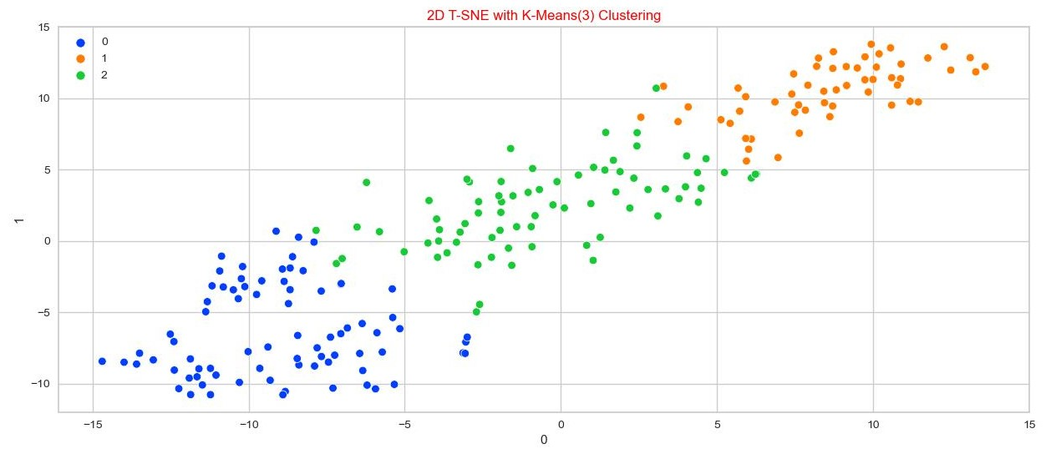
Model Selection and Validation:

Slide 52
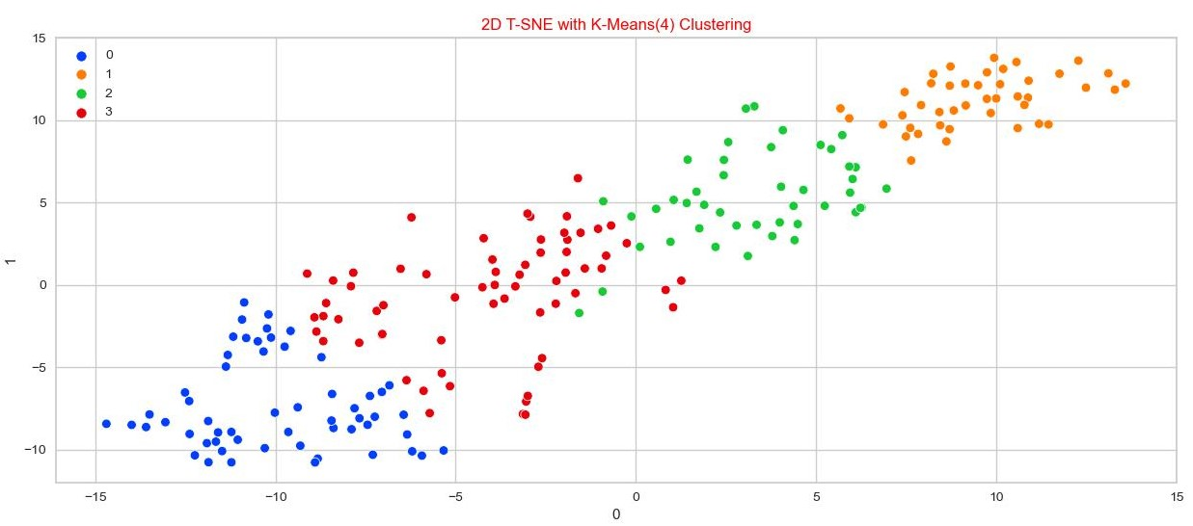
Model Selection and Validation:

Slide 53
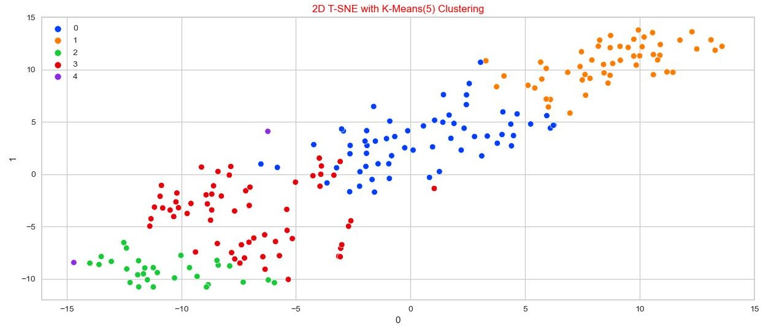
Model Selection and Validation:

Slide 54
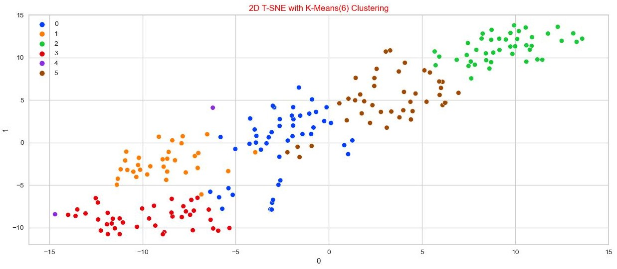
Model Selection and Validation:

Slide 55
Model Selection and Validation:
We can clearly see overfitting of the data in Kmeans models for K = 4,5 and 6.
As we are still unable to decide on the final model and we haven’t tested the data on the test dataset yet, we will use the K-Fold cross-validation technique.
K-Fold cross-validation :
K-fold cross-validation is a technique used in machine learning to evaluate the performance of a model. The data is split into K equal-sized subsets, and the model is trained K times, each time using a different subset as the validation set and the remaining subsets as the training set. This allows the model to be trained on all the data, while also being tested on all the data, providing a more accurate measure of performance.
K-Fold cross-validation on KMeans :
In our case, we used K-Fold cross-validation with K=5 i.e. on 5 equal-sized datasets.
We tested the model using K-Fold cross-validation for different Kmeans models for K values ranging from 2 to 10.
And we calculated WCSS and Silhouette scores for each test dataset and find mean WCSS and mean Silhouette Scores and repeat this for every KMeans model with distinct K-Value.

Slide 56
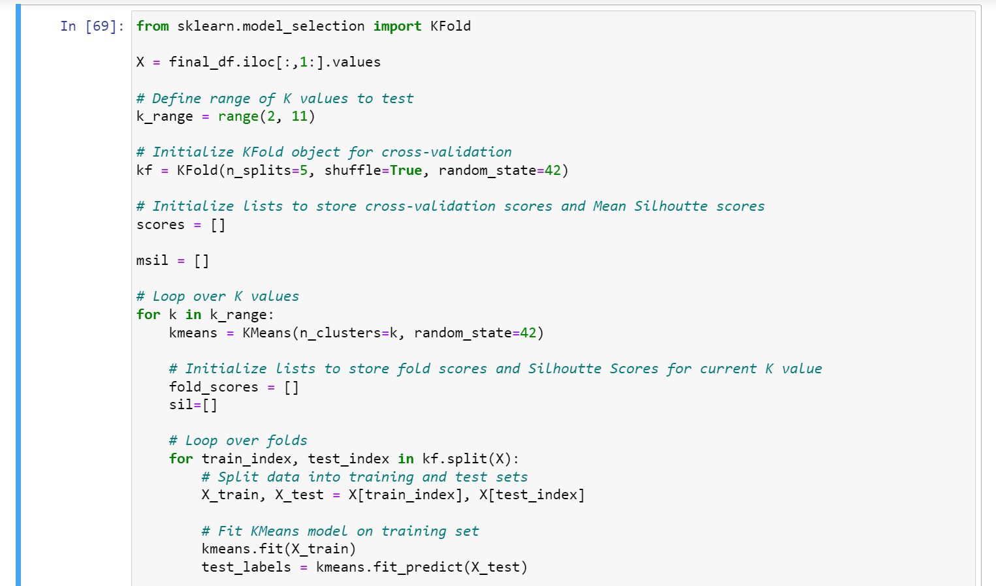
Model Selection and Validation:
#CODE for K-Fold cross-validation.

Slide 57
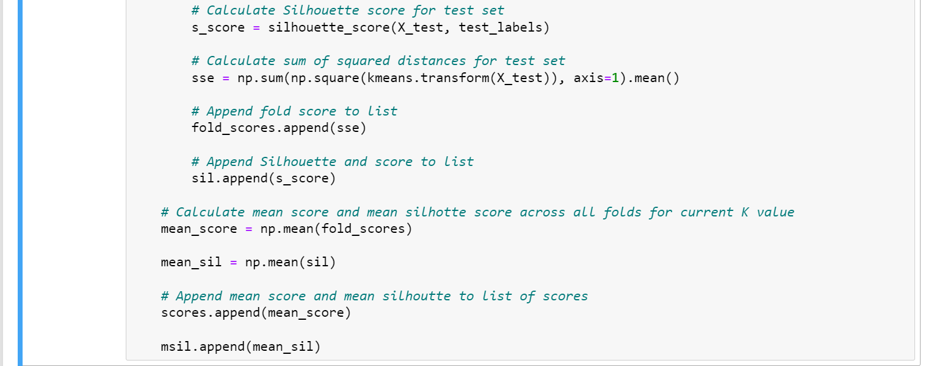
Model Selection and Validation:
#CODE for K-Fold cross-validation.

Slide 58
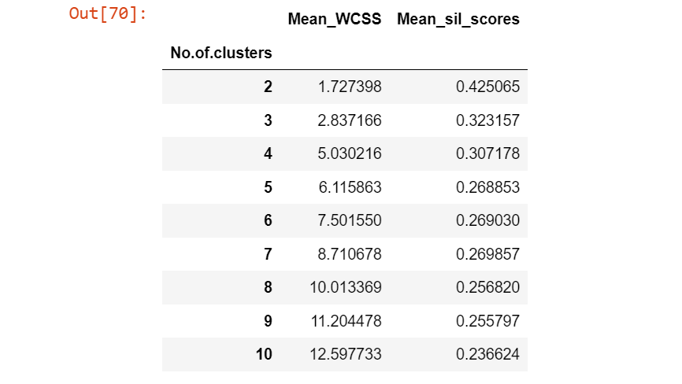
Model Selection and Validation:
#OUTPUT for K-Fold cross-validation.

Slide 59
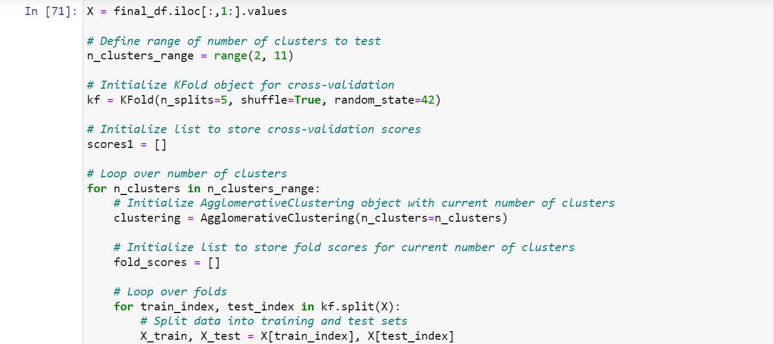
Model Selection and Validation:
K-Fold cross-validation on Hierarchical clustering :
In the case of Hierarchical clustering, we follow the same procedure that we followed in the case of Kmeans.
The only major difference is we use only the Silhouette score as the mean of validation.
#CODE for K-Fold cross-validation.

Slide 60
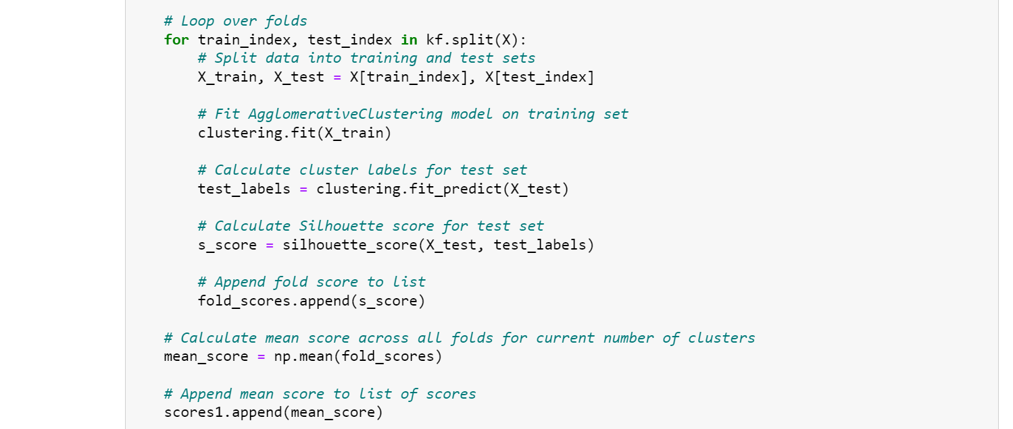
Model Selection and Validation:
#CODE for K-Fold cross-validation.

Slide 61
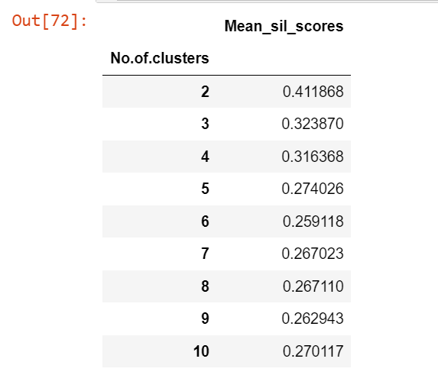
Model Selection and Validation:
#OUTPUT for K-Fold cross-validation.

Slide 62
Model Selection and Validation:
Conclusions and Decisions Made:
After using K-Fold cross-validation techniques on both Kmeans and Hierarchical Clustering,
For K-means Clustering:
We got the best scores for K=2, but it is inappropriate for our dataset.
So, we go with the next best value i.e. K=3.
For Hierarchical Clustering:
We got the best scores for K=2, but it is inappropriate for our dataset.
So, we go with the next best value i.e. K=3.
And the best scores of both the finalized models are almost equal
0.323157(K-Means) ~ 0.323870(Hierarchical)
So, both the models are performing well for both train and test datasets.
But we finalized the K-Means model with K=3, which has best Silhouette score according to our priorities for the data

Slide 63
Model Selection and Validation:
Conclusions and Decisions Made:
So, both models are performing well for both train and test datasets.
But we finalized the K-Means model with K=3, which has the best Silhouette score according to our priorities for our final_df dataset.
The main reason for this is the advantage of handling large data by the K-Means technique over the Hierarchical Technique.
So, we have built a finalized K-Means model with K=3 and final_df dataset and then we have saved the model in the ‘.pkl ’ extension using ‘dill’ for the deployment of the model.

Slide 64
Deployment:
We have decided to go forward with the Kmeans model with K=3 as our final model.
Now we need to deploy this model for the final user interface.
We already dumped the model using the ‘dill’ library for deployment purposes.
We used the “STREAMLIT” library for the deployment of the model.
We created a new Python file ‘app.py’ with the ‘.py’ extension.
Now we need to run the app using a command
‘!streamlit run app.py’
Before Writing the Code for the user interface we checked the mean value for all the countries within the same cluster.
We used GDP and tourism Inbound and Outbound as measures to finalize the country’s Development Index.
We then found that Clusters with Clustering id = 0 are Developed and Clustering id = 1 are Under Developed and Clustering id = 2 are Developing
We then wrote a function such that, The user can give all the inputs and they will be taken as a ‘numpy array’ as input.
Then the model will predict the Developing measure of a Country.

Slide 65

Deployment:
#CODE for Deployment.

Slide 66

Deployment:
#CODE for Deployment.

Slide 67

Deployment:
#CODE for Deployment.

Slide 68

Deployment:
#CODE for Deployment.

Slide 69

Deployment:
#Output after Deployment.

Slide 70
Deployment:
What we have done in Deployment Code?:
What User can see?:
First we imported all the necessary libraries such as streamlit, numpy, dill etc.,
Then we created the text input boxes for all the necessary inputs and labelled them proper instructions on what to give as inputs.
Since we used 22 features while building our model, we built 22 input fields in our interface.
Then we created a button ‘Predict’ , to get the results.
What happens in the backend?:
We created a function called ‘Cluster_prediction’ which takes the data as input in the form of 2-D numpy array.
Then these data will be ‘Normalized’ using MinMaxScaler() method.
We did this because, the data on which we build the model has normalized data.
Now we load the pre dumped model to access the pre build model.
We then pass this data into the loaded model, and store the result in a form of list.
We then wrote a conditional code, such that if the result is ‘0’ function returns a String 'DEVELOPED COUNTRY’ .
If the result is ‘1’ then it returns a string 'UNDER DEVELOPED COUNTRY’ .
Else it results a string 'DEVELOPING COUNTRY’.

Slide 71
Deployment:
What we have done in Deployment Code?:
What happens in the backend?:
We already built a button ‘Predict’ , when it is clicked it runs the function ‘Cluster_Prediction’ with the data from all input fields taken as input for the function Cluster_prediction and stores the results in a variable called ‘Predict’.
We also adorned the output such that, each result appear in a different color.
If model predicts ‘0’ , the output after clicking ‘Predict’ button will look like this
This is a Developed Country.
If model predicts ‘1’ , the output after clicking ‘Predict’ button will look like this
This is a Under Developed Country.
If model predicts ‘2’ , the output after clicking ‘Predict’ button will look like this
This is a Developing Country.

Slide 72
Thank you

